Slide 1
Hoarding

Slide 3
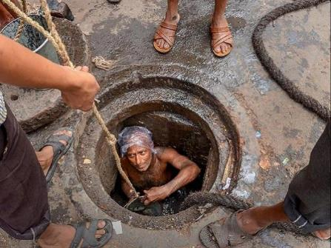
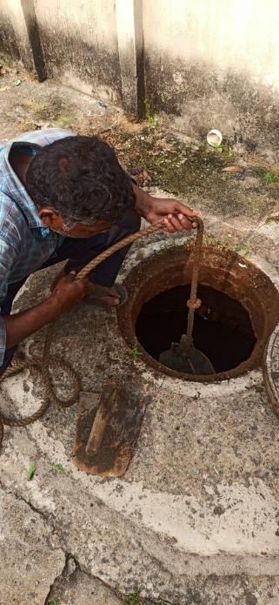
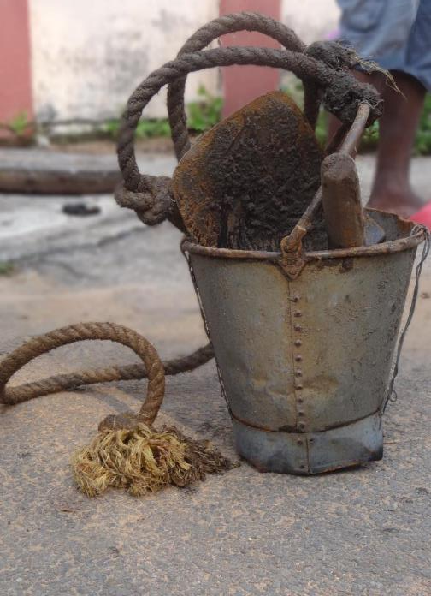
Of the 5 million sanitation workers working in India, an estimated 2.5 million deal with occupational hazards everyday
Invisibility and neglect
Occupational stigma
Caste based occupation
Weak legal protection

Slide 4
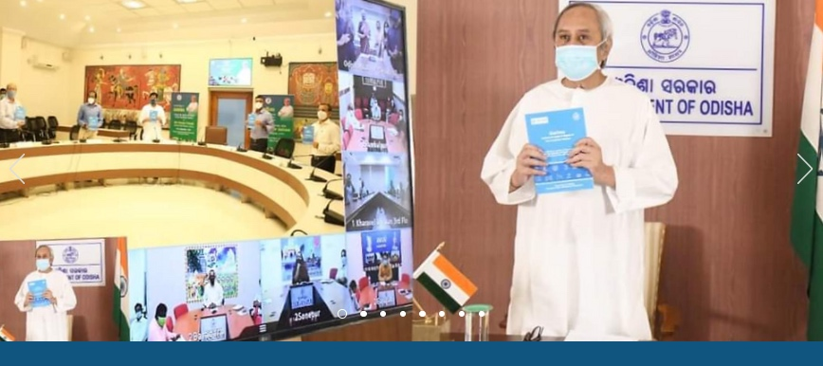
Launch of Garima Scheme
Launched by Hon’ble Chief Minister of Odisha on 11th September 2020
For protection & welfare of core sanitation worker
Notes:
We can include a photograph of Hon’ble CM and PS HUDD launching the scheme, if required

Slide 5
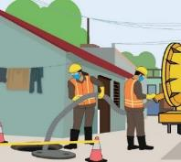
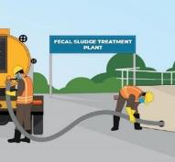
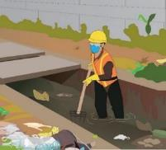
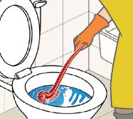
Core Sanitation Work Categories Included in the scheme "Garima"
(Highly Skilled –Core Sanitation Worker Grade-I:)
(Skilled –Core Sanitation Worker Grade-II:)
Operation & Maintenance of Sewer network
Operation & Maintenance of FSTP/ STP/ SeTP
Septic Tank Cleaning
Drain Cleaning
Public / Community
Toilet Cleaning
Fecal Sludge Treatment Plant
Notes:
Icons from vector stock

Slide 6
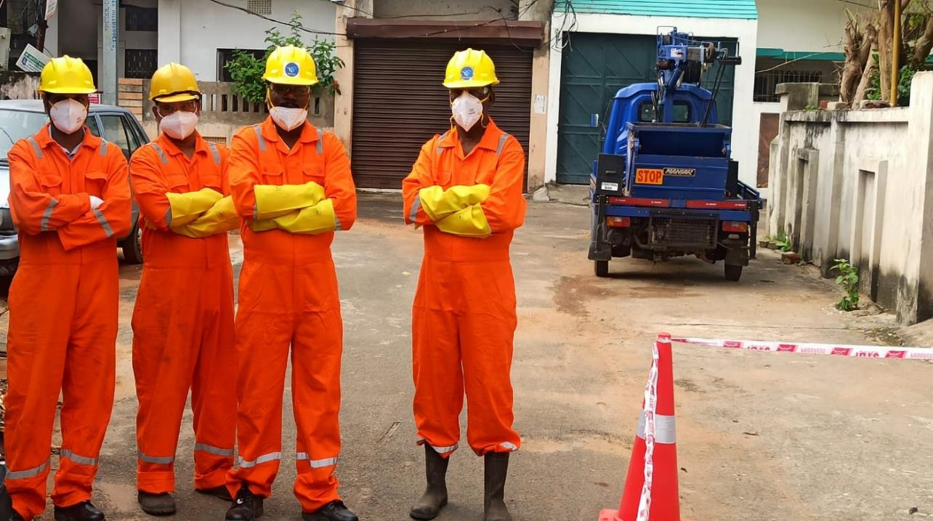
Scheme Components
Regulating and institutionalizing core sanitation services
Provision of service level benefits to core sanitation workers and creating a safe and dignified working environment
1
3
2
Creation of
skilled sanitation workforce
Provision of social security benefits to core sanitation workers and their benefits
4

Slide 7
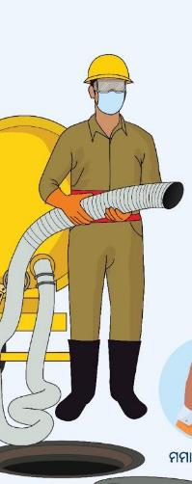
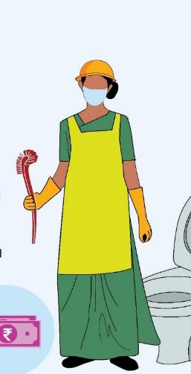
ନିଶ୍ଚିତ ସର୍ବନିମ୍ନ ମଜୁରୀ
Benefits for Core Sanitation Workers - Corpus Fund
has been Created
Pucca House
Livelihood Support for the Family
Life Insurance &
Health Insurance
Mobile Phone
Free Education for Children
Two -Wheeler
Periodic Health Check up
Assured Minimum
Wage
Notes:
Location: Wall adjacent to Changing cum storage room
Type: Digital Display

Slide 8
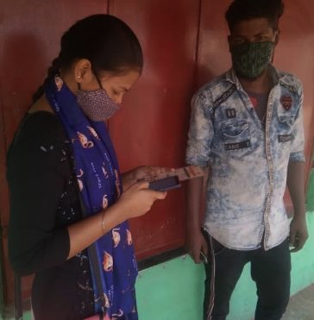
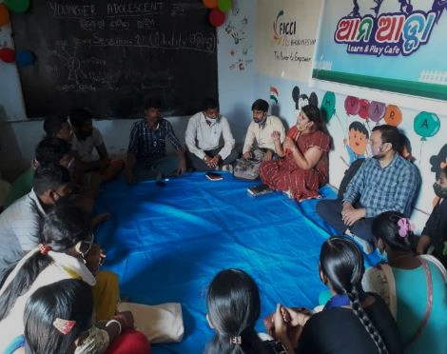
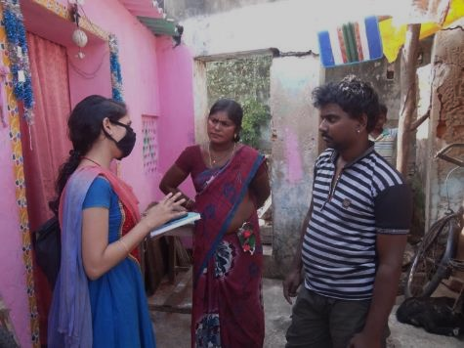
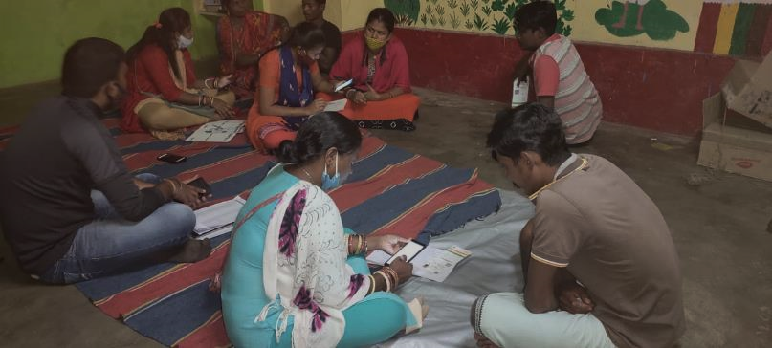
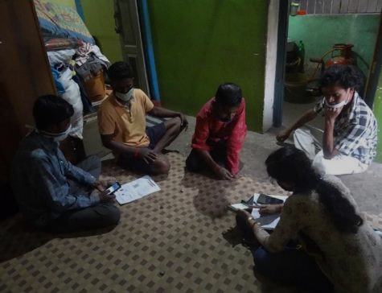
Achievements under the scheme so far
First extensive enumeration program conducted for identification of CSWs
CSWs identified and validated across 6 pilot cities
5018
CSWs identified across 108 cities and going on
4107
Garima IDs being distributed to validated workers with a Unique Identification Number
UID

Slide 9
Assured Minimum Wage and Risk & Hardship Allowance for Core Sanitation Workers
ଖୋଲା ନାଳ ସଫେଇ
Categorisation based on skill
Higher Minimum Wage
Risk & Hardship Allowance
Other Benefits
Categorisation leads hike in Minimum Wage
Highly Skilled category of CSWs are granted for Risk & Hardship Allowance as
୧୫ %
of their daily wage
Work Hour for Core Sanitation Worker has reduced from 8 hours to
Disablement Compensation to Core Sanitation Workers if there is any disability & illness due to accident at worksite
Core Sanitation Work included in Highly Skilled and Skilled Category of Scheduled employment
Highly Skilled –
Grade-I:
Skilled –
Grade-II:
Highly Skilled –
Grade-I:
Skilled –
Grade-II:
6 hours
₹326
₹326
Operation & Maintenance of Sewer network
Public / Community
Toilet Cleaning
15 %
Operation & Maintenance of FSTP/ STP/ SeTP
Septic Tank Cleaning
₹476
₹416
Drain Cleaning

Slide 10
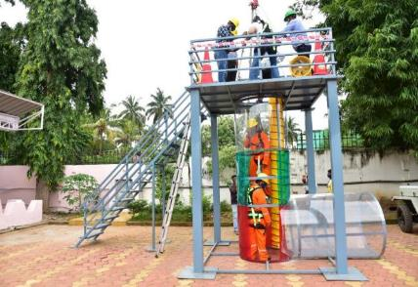
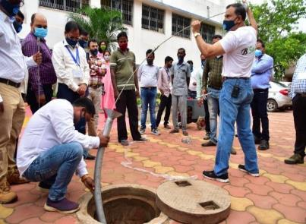
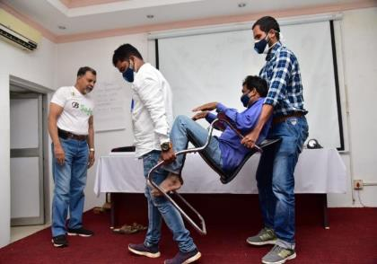
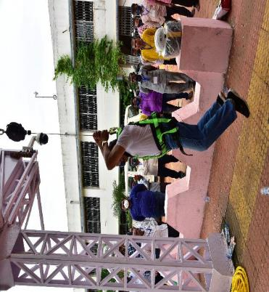
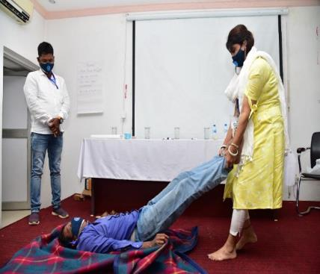
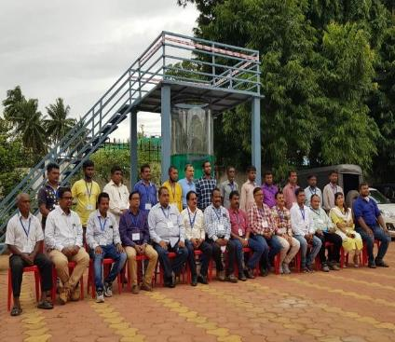
Skill Development Training to Core Sanitation Worker at Odisha Water Academy
71
Master Trainers certified to provide Sewer Entry Professionals Training to CSWs

Slide 11
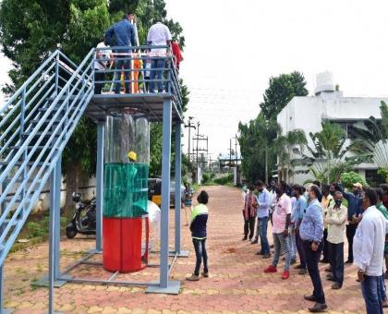
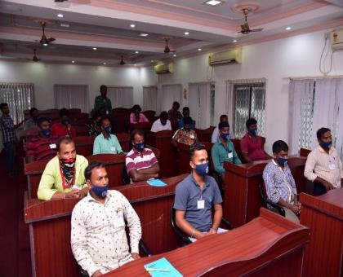
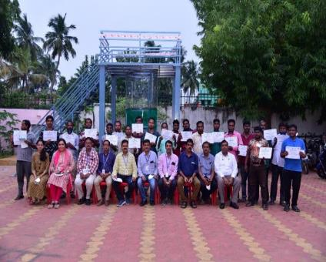
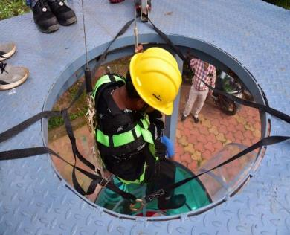
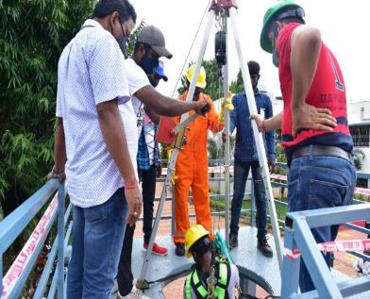
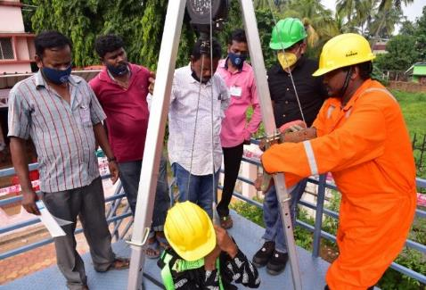
Skill Development Training to Core Sanitation Worker at Odisha Water Academy
Highly Skilled Core Sanitation Worker trained as Sewer Entry Professionals
280

Slide 12
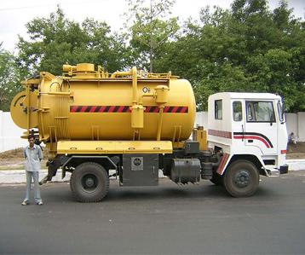
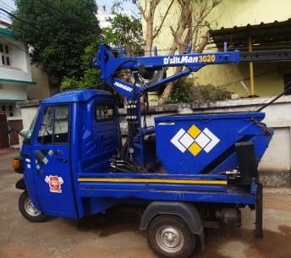
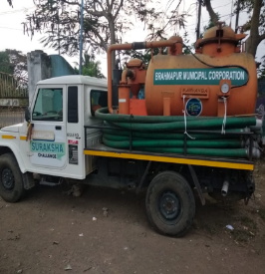
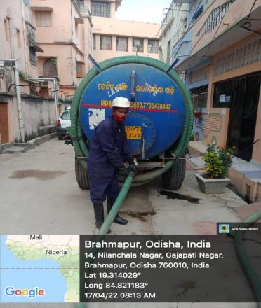
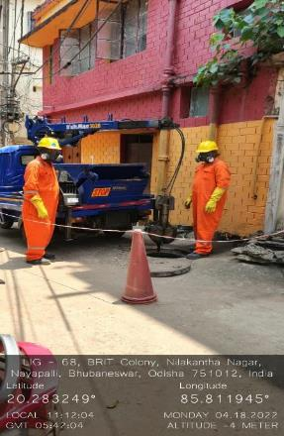
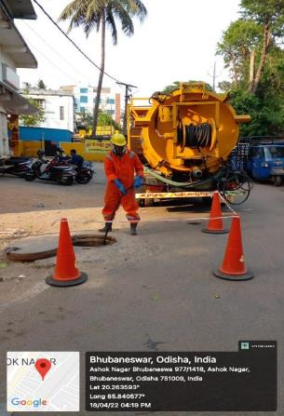
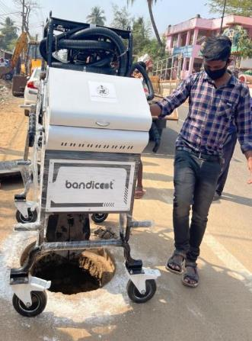
“Man hole” to “Machine hole ”

Slide 13
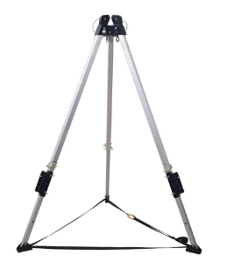
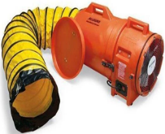
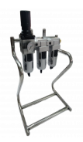
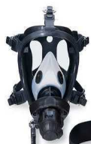
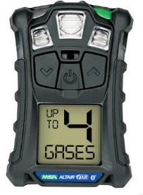
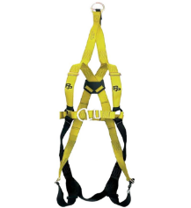
Safety Devices
Fan Blower
Tripod
Airline respiratory devices
Gas detector
Body Harness

Slide 14
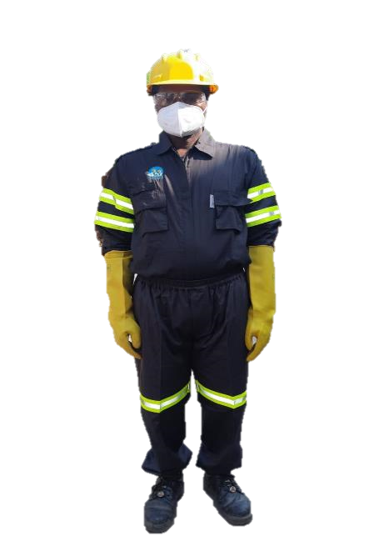
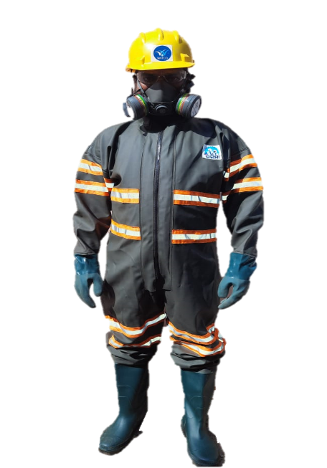
Protective Uniform with “Garima “ branding for CSWs

Slide 15
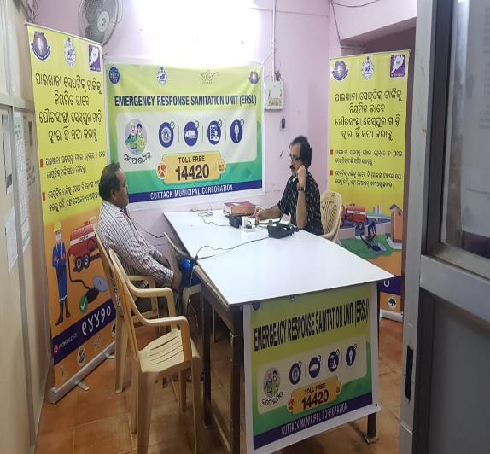
Emergency Response Sanitation Units has been set up in 114 Cities to Control the Manual cleaning
Punishment for Illegal Cleaning
Offence | Fine | Imprisonment | Punishment
First time Offence | Up to 2 lakh | Up to 2 year | Fine or Imprisonment or Both
Consecutive Offence | Up to 5 lakh | Up to 5 Year
14420 Helpline is operational in 98 Cities for receipt of sanitation requests

Slide 16
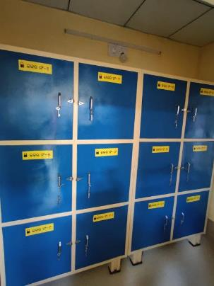
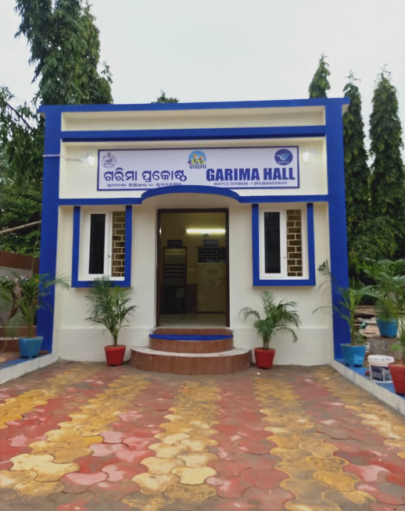
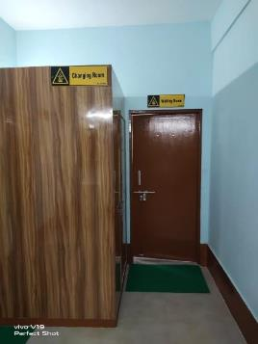
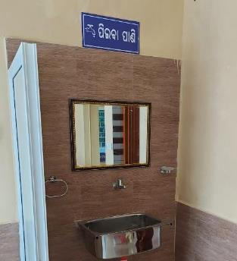
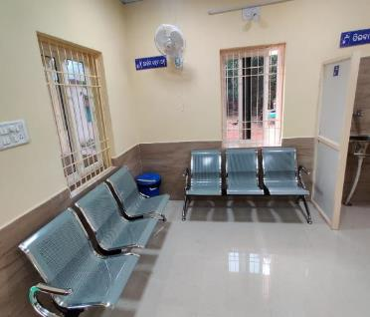
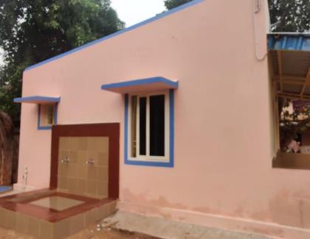
Special Resting lounges called “Garima Grihas” for CSWs
External Washing area
Changing Room
Personal lockers
Washroom
Waiting/Resting Room

Slide 17
Babuli Nayak
THEN
A STORY OF CHANGE
Babuli Nayak
NOW

Slide 18
SAFAIMITRA SURAKSHA

Slide 19
Highlights
7 Safaimitra Challenge cities (Berhampur, Bhubaneswar, Cuttack, Rourkela & Sambalpur Municipal Corporation & Puri & Balasore Municipality)
3 Lighthouse cities (Berhampur, Bhubaneswar& Balasore Municipality)
ERSU established and RSA notified in 114 Cities
PPE, Safety Devices and Cleaning equipment has been procured and 100% in use
Manual Cleaning is strictly banned and monitored closely

Slide 20
Key interventions in SafaiMitra Suraksha
Vision: 100% ULBs to have the required number of machines and equipment to eliminate manual entry into Sewers/ Septic Tanks
Functional Responsible Sanitation Authority (RSA) in 114 Ciities
Activating and publicizing 14420 helpline
Budget provisioned from State towards procurement of required equipment and Safety Devices
Empanelment of Private Sanitation Service Organisations (PSSOs)
Enumeration and skilling of Sewer Entry Professionals (SEPs)
Safety Gear for SEPs–procured and stocked By ULBs and Parastatals
State level guidelines/advisory issued for elimination of hazardous entry
Target of training 2000 Safai Mitras (sewermenm, beldars and SEPs) during FY 2022-23 in 114 cities
Formation of Self Help Groups and facilitate loans for SafaiMitras through Swachhta Udyami Yojana for FY 2022-23
Promotion of public awareness on 14420, safe practices for desludging, etc

Slide 21
Housing & Urban Development Department, Government of Odisha

