Slide 1





2023
#Mera Shahar, Meri Pehchan
23
Waste to Wealth
Toolkit

Slide 2



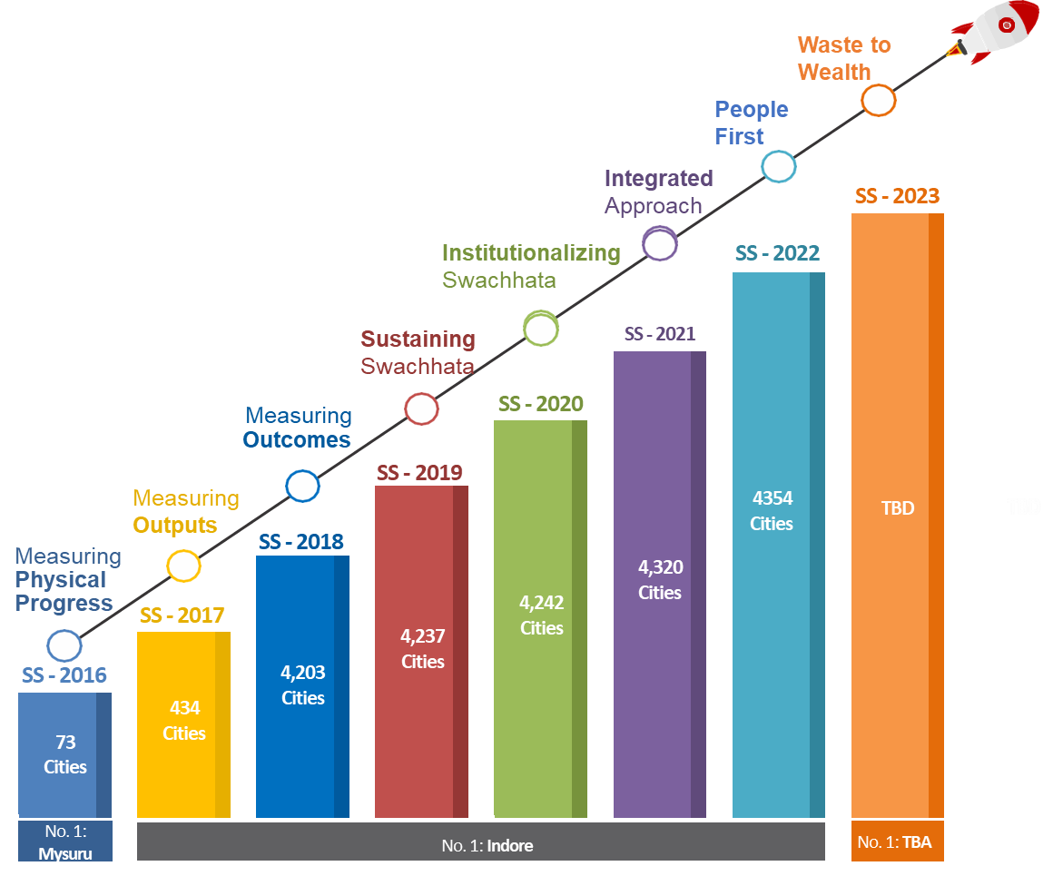
Evolution of Swachh Survekshan (SS)
TBA:
To be announced

Slide 3
Key objectives of Swachh Survekshan
Annual urban sanitation survey conducted by MoHUA through a 3rd Party Assessment Agency
Objectives
1
1
2
3
4
Act as enabler for Mission acceleration in the cities
Foster healthy competition among cities to improve their performance on sanitation parameters
Encourage large scale citizen participation and create awareness about importance of Swachhata
Improved sanitation services delivery by cities to its citizens
Foster healthy competition among cities to improve their performance on sanitation parameters
Emerged as the largest urban sanitation survey in the world

Slide 4
Key points to note for SS 2023
1
ULBs formed on or before 31st Dec’21 will be assessed in SS 2023.
2
ULBs formed after 31st Dec’21 may be included on formal request to MoHUA from the respective State/UT.
3
The period to be covered under the assessment of Phase-4 shall be October 2022 to March 2023*.
4
Always maintain complete and accurate data on Swachhatam Portal, as it will be used for conducting field assessment (discrepancies will attract –ve marking).
5
Always maintain updated contact details of the respective ULB representatives, on the Swachhatam Portal.
6
Failure to provide supporting documents may lead to losing marks in the respective indicator
*except for those indicators where any other specific date is mentioned

Slide 5



Summary of all amendments made in SS 2023 Toolkit (till date)
Indicator 1.1 on ‘segregated waste collection’ of 600 marks has been divided into 2 separate indicators - one on ‘door-to-door waste collection’ and the other on ‘source segregation’ of waste, with 300 marks allocated to each.
Indicator 1.5 on ‘ban on SUP’ has been modified. The sub-indicators on ‘comprehensive action plan preparation’ and ‘1 tender approved’ have been removed and the marks reallocated within other indicators.
The following indicators have been removed:
  Indicator no. 1.6(a) & 1.6(b)- 100% Staff Completed minimum 4 Courses through e-Learning platform of Swachh Bharat Mission (U) & Skill Development Training
  Indicator no. 1.7(a) - Reusable cutlery used, and 200 ml water bottled stopped in all functions where catering services are provided by them.
  Indicator 1.7 (b) on ‘promoting establishment of sustainable enterprises driven by 3R principles’ has been modified into ‘promotion of Reduce Reuse and Recycle’ and placed at indicator 1.6.

Slide 6
Summary of all amendments made in SS 2023 Toolkit (till date)
Indicator 1.7 (c) on ‘Waste to Wonder Park’ and ‘waste to art sculptures’ has been modified to at least one of either of the above, in the ULB.
Indicator 1.7 (d) on ‘Zero waste events’, the scheme of marking has been modified.
Indicator 1.9 on ‘Swachh Tulip’ added as a new indicator primarily for >1 lakh population cities.
Indicator 2.6 on C&D waste management has been bifurcated into two sub-indicators – 2.6A for non-NCAP cities and 2.6B for NCAP cities.
Indicator 2.9 on ‘remediation of legacy dumpsites’ has been modified – an additional band added in the ‘work completion’ under scheme of marking.
Indicator 2.10 on ‘whether the landfill in the city is a sanitary landfill’ has been modified for >1lakh and <1 lakh cities and placed at 2.7A and 2.7B.
Indicator 2.11 on ‘onsite processing of wet waste by non-bulk waste generators’ has been modified and moved to the ‘citizen voice’ section.

Slide 7
Summary of all amendments made in SS 2023 Toolkit (till date)
The bands of scheme of marking for the indicators under ‘processing and disposal’ component have been made equivalent to the ones in GFC Star Rating Protocol, to extent possible.
The indicator on ‘CTs & PTs prominently displaying SBM-U messages’ has been moved from ‘citizen voice’ component to indicator 3.4 under ‘UWM & Safaimitra Suraksha’ component.
The total marks on ‘Safaimitra Suraksha’ has been increased to 750, as each city needs to saturate themselves in this component on priority.
As was indicated to the Cities earlier ‘participation in campaigns driven by MoHUA’ has been added as a new indicator with 100 marks under Citizen Voice.
Under the indicator on grievance redressal ‘Swachhata App & Local App’, only one sub indicator has been retained, i.e., ‘%age of complaints resolved’.
The final scores for ranking of Ganga Towns will be calculated based on the scoring of Ganga Towns (ULB’s score in SS 2023) and the Ganga Ghats.

Slide 8



Methodology

Slide 9
Evaluation parameters
SS-2023 Total Marks 9,500
26%
Certification 2,500 Marks
51%
23%
Service Level
Citizens’ Voice 2,170 Marks
Progress 4,830 Marks
SS-2022 Total Marks 7,500
30%
Certification 2,250 Marks
40%
30%
Service Level
Citizens’ Voice 2,250 Marks
Progress 3,000 Marks

Slide 10


Service Level Progress
Indicators
Total 4,830 Marks

Slide 11
SS 2023 - Assessment to be done in 4 phases
SS-2022 Indicators
Ph-1
338 Marks
On-Call Validation
Ph-1
Apr - May
Ph-1
(7% of 4,830)
Ph-2
June - July
SS-2022 Indicators
Ph-2
483 Marks
On-Call Validation
Ph-2
(10% of 4,830)
SS-2023 Indicators
Ph-3
1739 Marks
On-Field visit to processing facilities
Ph-3
Aug - Sep
Ph-3
(36% of 4,830)
SS-2023 Indicators
Ph-4
2,270 Marks
On-Field Validation
(All indicators to be validated)
Ph-4
Oct’22 – Mar’23
Ph-4
(47% of 4,830)
Total
4,830 marks
Note: Ph-1 & 2 will be assessed on the basis of Service Level Progress indicators designed for SS-2022

Slide 12
SS-2022 Total Marks 3,000
Changes in Service Level Progress Marks
SS-2023 Total Marks 4,830
40%
Processing & Disposal
1,910 Marks
33%
Segregated Collection
1,600 Marks
27%
UWM &
Safaimitra
Suraksha
1,320 Marks
40%
Processing & Disposal
1,200 Marks
30%
Segregated Collection
900 Marks
30%
Sustainable Sanitation & Safaimitra Suraksha
900 Marks

Slide 13
SLP scoring methodology
Each indicator of the Service Level Progress is cross validated with the data retrieved from a combination of all or few of the following :
Direct Observation/On Field Assessment
Citizen Validation in field
On Call Citizen Validation
Data from Swachhatam Portal
Incorrect claims by ULB(s) in the SLP will invoke negative marking through Independent Validation Matrix.

Slide 14

State Ranking: Performance Parameters
Two Categories: (1) States with >100 ULBs; and (2) States with <100 ULBs | Max: 6000 Marks
15% Weightage (900 Marks)
Support from State to ULBs
(As on 31st March 2023)
20% Weightage
(1200 Marks)
GFC and ODF+/++/Water+
30% Weightage (1800 Marks)
State Level Key Performance Indicators
35% Weightage (2100 Marks)
Performance in SS-2023
(SLP + Citizen Voice)
State led policy initiatives to promote comprehensive waste management in ULBs, e.g. Land to be given on priority for Solid Waste Management. (300)
State directive(s) to ULBs for Safaimitra Suraksha. (300)
What percentage of ULBs have uploaded CSAP and CSWAPs on SBM-U 2.0 MIS (Swachhatam Portal)? (300)
Garbage Free City for Star Rating - % of cities in the State are certified (600 Marks)
  >= 5 Star
  3 Star
  1 Star
Open Defecation Free - % of cities in the state are certified (600 Marks)
  Water+
  ODF++
  ODF+
State Level Percentage of Door-to-Door Collection percentage (400 Marks)
State Level Percentage of segregation of waste (three categories) (500 Marks)
Availability of designed capacity for processing of waste (Wet, Dry, Sewage, Faecal Sludge, C&D) (400 Marks)
Percentage of ULBs declared as Safaimitra Surakshit Seher (500 Marks)
  Average Marks scored by the state in SS2023 in Service Level Progress (SLP) + Citizen Voice Section.
  Note:
  a) Certification Section will be excluded while calculating the marks for this section

Slide 15
Points to Remember
ULBs are advised to update their MIS/City Profile on the basis of electoral wards only – administrative wards will not be considered. In all such cases, where electoral wards are not in place, administrative wards will be considered upon approval by MoHUA
A declaration (section wise) from the Executive Officers confirming the monthly progress ‘claimed’ will be considered as a documentary support for first two phases for ULBs with >1 L population.
The declaration from Administrator will be included if ULB has been dissolved and Administrator has been appointed by the State (wherever applicable).
Commercial area in residential areas under ‘Mixed-land Use’
  Commercial area is real estate intended for use by for-profit businesses, such as office complexes, shopping malls, service stations and restaurants.
  Please note, number of shops (floor wise or in a row and either side or only one side of the road), as per following criteria, in residential area shall be qualified as commercial area
ULB’s Population Category | Up to 25K | Between 25K - 50K | Between 50K - 1 Lakh | Between 1 Lakh – 3 Lakh | Above 3 Lakh
Number of Shops | 10 | 20 | 50 | 75 | 100

Slide 16
1. SEGREGATED COLLECTION
40%
Processing & Disposal
1,910 Marks
33%
Segregated Collection
1,600 Marks
27%
UWM &
Safaimitra Suraksha
1,320 Marks
Total Number of Indicators: 10
1,600 Marks / 4,830 Marks

Slide 17
Summary – Section 1
No. | Indicator | Marks
1.1 | Door-to-door Collection | 300
1.2 | Segregation at Source | 300
1.3 | Cleanliness of Public Areas | 300
1.4 | Clean SWDs/Nallahs & Waterbodies | 75
1.5 | Ban on Single Use Plastic | 150
1.6 | Promotion of RRR Centers | 80
1.7 | Waste to Wonder Park/Sculpture | 100
1.8 | Zero Waste Events | 90
1.9 | Swachh Tulip | 75
1.10 | Benefits to the Sanitary Workers & Informal Waste Pickers | 130
 | Total (Segregated Collection) | 1,600

Slide 18
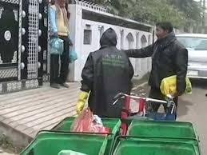
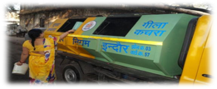
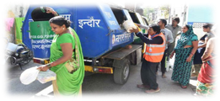
1.1
%age of wards covered with 100% door-to-door waste collection
Marks
300
(Coverage of wards means every unit of household/gates , commercial establishment and shops in the ward).
This parameter examines whether ULB has a system in place for door-to-door collection of waste.
Scheme of Marking | Marks
Door-to-door collection in 100% Wards | 300
Door-to-door collection in at least 90% Wards | 200
Door-to-door collection in at least 70% Wards | 150
Door-to-door collection in at least 50% Wards | 100
Door-to-door collection in < 50% Wards | 0

Slide 19
1.2
%age of Wards covered with 100% Segregation of Waste at source
(wet, dry, sanitary & domestic hazardous)
Marks
300
(Coverage of wards means every unit of household/gates , commercial establishment and shops in the ward).
This parameter examines whether ULB has a system in place for door-to-door collection of waste.
Scheme of Marking | Marks
Segregated Waste collected in at least 90% Wards | 300
Segregated Waste collected in at least 80% Wards | 200
Segregated Waste collected in at least 60% Wards | 150
Segregated Waste collected in at least 40% Wards | 50
Segregated Waste collected in < 40% Wards | 0

Slide 20
1.1 and 1.2 Key definitions & notes
Wet waste to be collected on daily basis.
ULBs may also opt for collection of dry waste on alternate days/twice or once in a week basis.
100% waste generated is to be collected in wards covered under this indicator excluding bulk waste generators and non-bulk waste generators practicing on-site processing.
Gate: Point from where the waste collector collects waste. For independent houses, the door will be considered as a gate whereas in residential societies, generally there is a single point from where these collectors collect their waste.
Sanitary waste : Menstrual waste and diapers.
Domestic Hazardous waste: Discarded paint drums, pesticide cans, CFL bulbs, tube lights, expired medicines, broken mercury thermometers, used batteries, used needles and syringes and contaminated gauge, etc., generated at the household level – which can be collected on a weekly basis.
>1 Lakh population cities advised to collect segregated waste separately from households, mandi, streets/commercial areas/litter bins, hotel/restaurants, parks/horticulture waste and religious places.

Slide 21
1.1 & 1.2 Validation methodology
The data filled in Swachhatam MIS portal will be validated through Citizen Validation conducted in Residential and Commercial Areas in each ward on sampling basis.
Questions related to Segregated Collection of waste and the frequency of collection by the ULBs will be asked to citizens and validated accordingly.
On Field assessors will visit households/shops randomly and conduct the independent citizen validation.

Slide 22
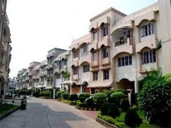
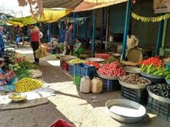
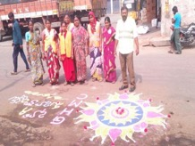
1.3
Cleaning of Public Areas
Marks
300
This parameter is to examine whether all the commercial areas and transportation hubs in the city are swept at least twice a day including festivals and Sundays (with mandatory night sweeping , elimination of GVPs ), daily sweeping in all residential wards, and city is Bin-free city.
Scheme of Marking | Marks
Twice a day sweeping (including night sweeping) in all Public & commercial areas roads and streets, and other relevant areas – cleanliness maintained. | 30
Once a day sweeping in all residential areas – cleanliness maintained. | 30
All back lanes of Commercial/Residential areas are clean - no water logging, drainage system not choked, no solid waste floating and walls properly maintained | 120
No storage bins (>100 Litre size) in all wards, all empty plots are free from C&D/solid waste dump and the waste is not burnt in any part of the city | 20
5. Zero Garbage Vulnerable Points in ULB’s jurisdiction | 20
6 Zero ‘Red Spots’ (Spitting in Commercial/Residential areas) in ULB’s Jurisdiction | 80

Slide 23
Key definitions
Public & commercial areas includes market areas (Vegetable/Fruit and Meat/Fish Markets including Mandi (APMC) and weekly market), railway stations, bus stations, other transport hubs, schools, colleges, hospitals, offices, religious areas, industrial areas, institutional areas, ULB managed parking areas, City parks & gardens), roads and streets, and other relevant areas.
ULBs are expected to maintain cleanliness in the back side of the commercial buildings/office complexes, back side of houses, religious places or any building in the city which generally is not covered under daily cleaning and maintenance.
Mechanized cleaning for 4-lane roads in ULBs with >10L population and water spray/sprinkling in cities <10L Population
1.3 Validation methodology
Direct Observation and citizen validation in residential and commercial areas will be carried out by the Assessors

Slide 24



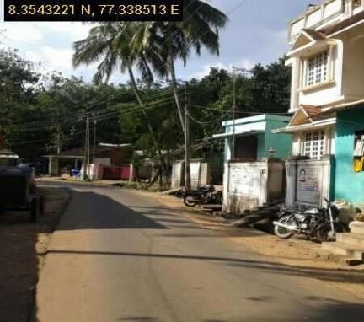
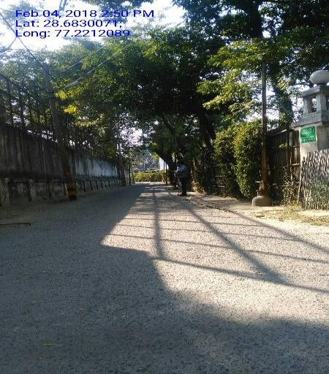
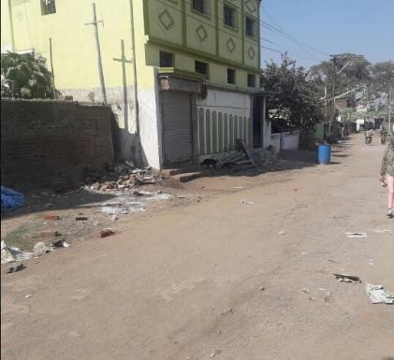
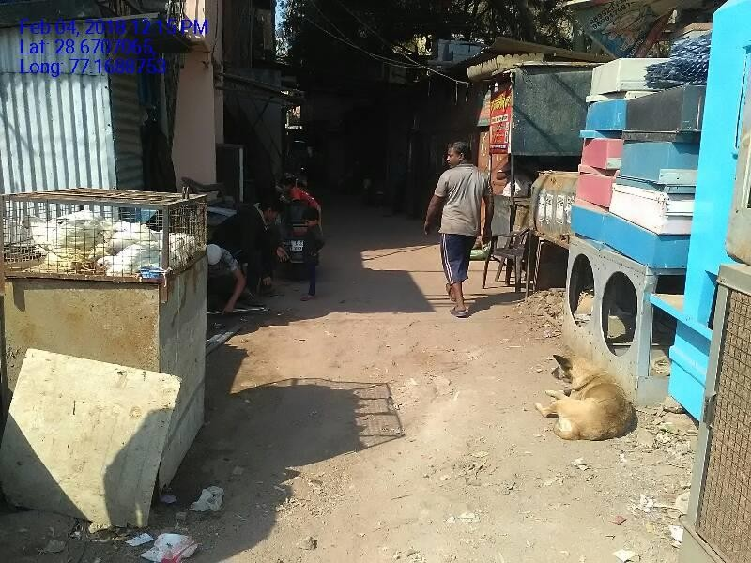
Residential Area Clean
100% clean (zero waste spotted)
Not clean

Slide 25
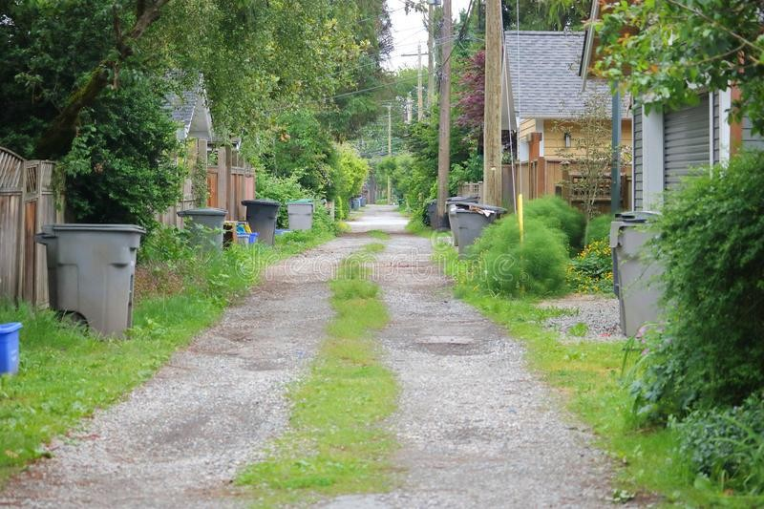
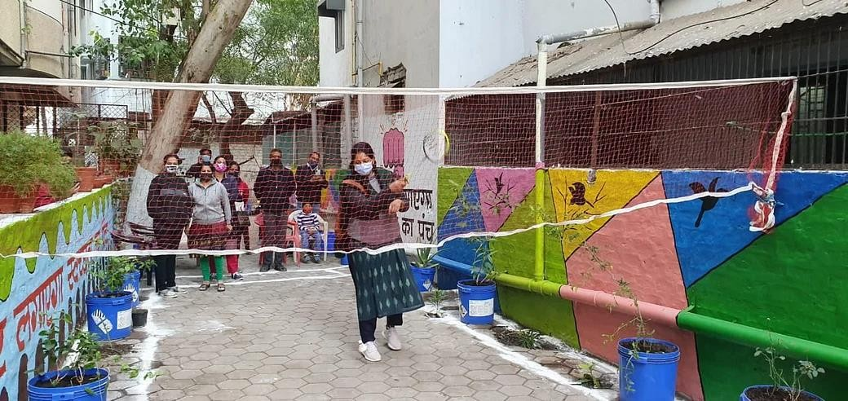
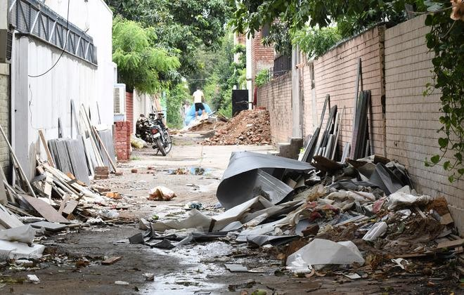
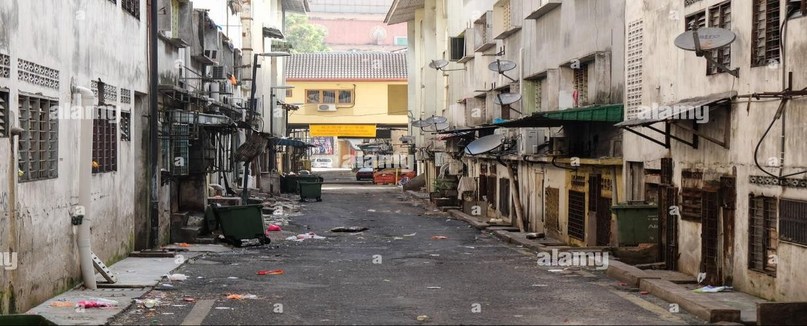
Back lanes of the residential area clean
Clean (Back lanes of the residential area)
Back lanes not clean

Slide 26
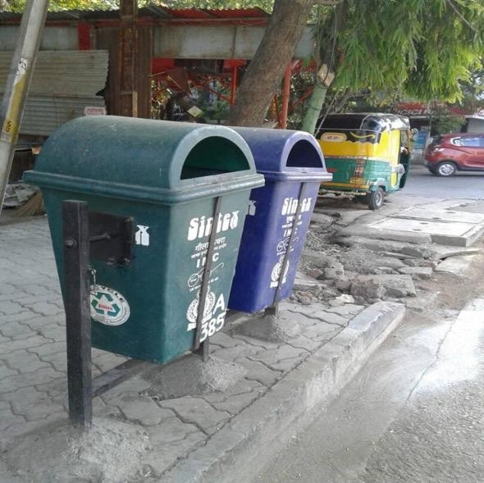
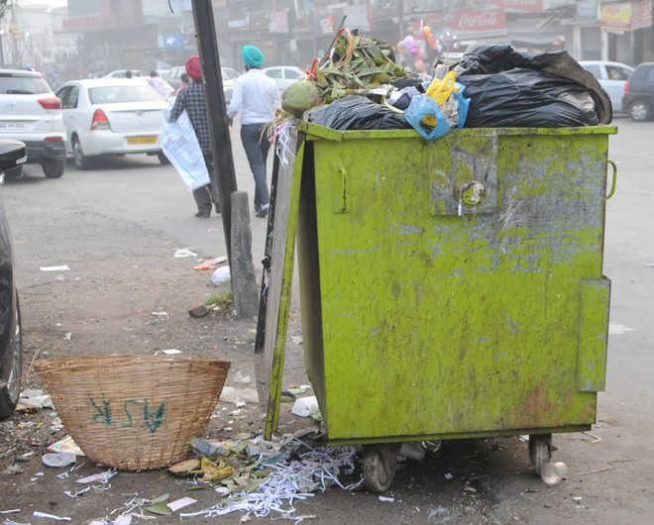
Residential Area Bin Free
Twin Bin
Not bin free
Twin Bins are acceptable, even encouraged.
Secondary Storage bin such as these are discouraged

Slide 27
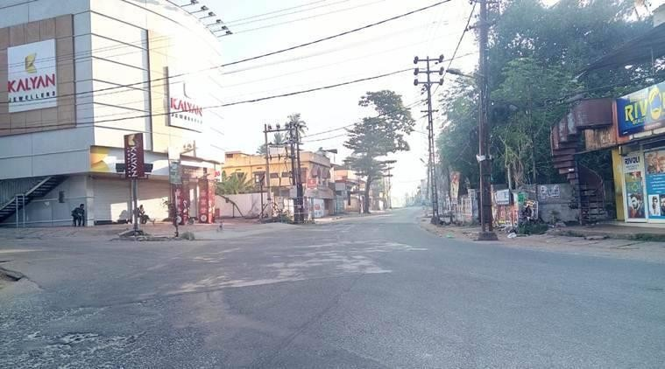
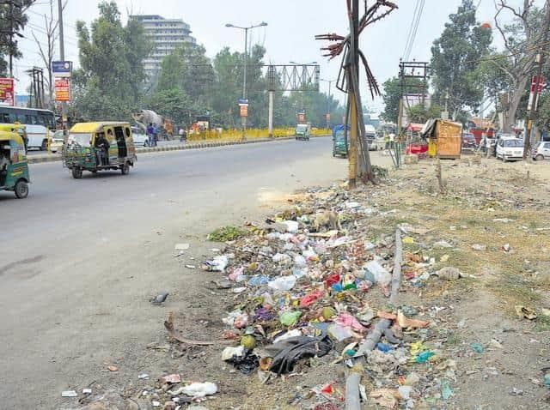
Photograph of clean street
Photograph of unclean street

Slide 28
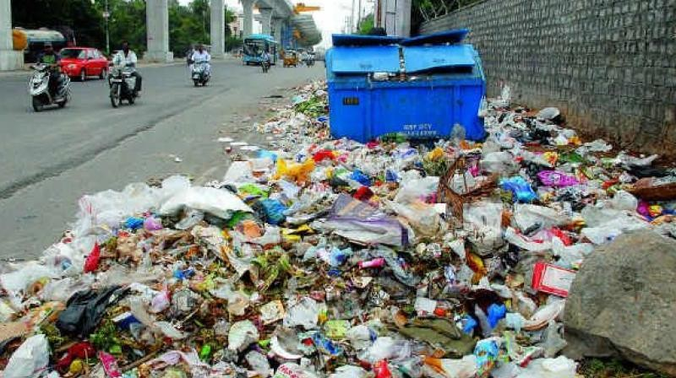
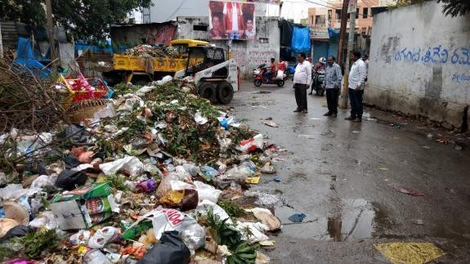
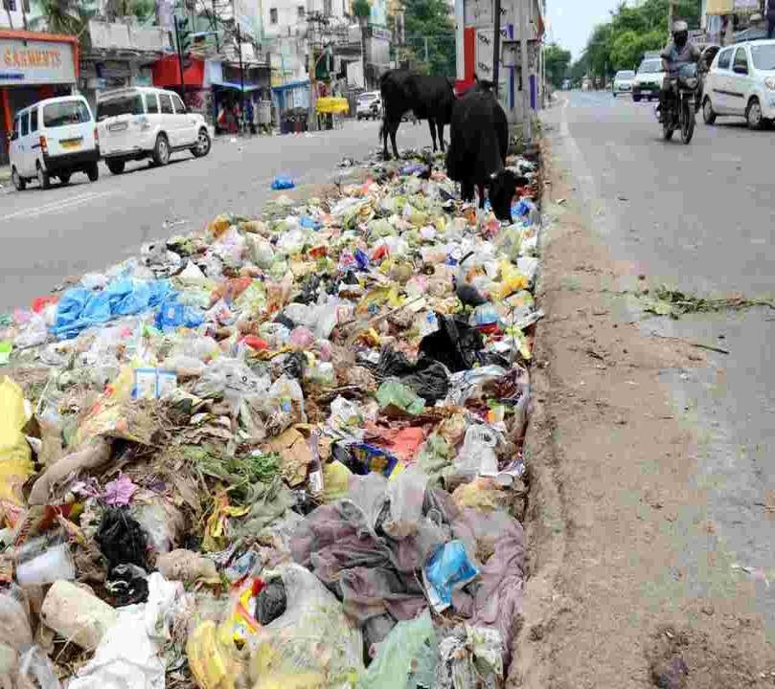
GARBAGE VULNERABLE POINT
Garbage Vulnerable Points (GVP) are those areas where the garbage gets piled up because of the constant dumping of garbage by the local residents, travelers, or passerby.

Slide 29
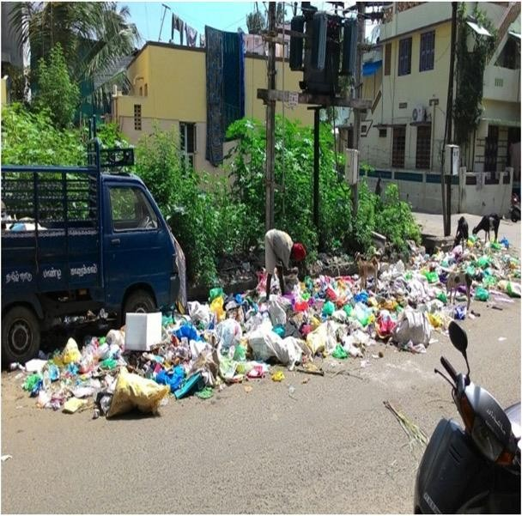
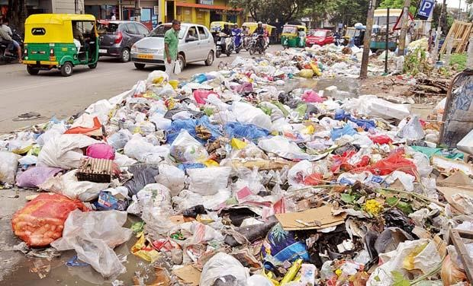
Photograph of GVP near residential area
Photograph of GVP near commercial area

Slide 30

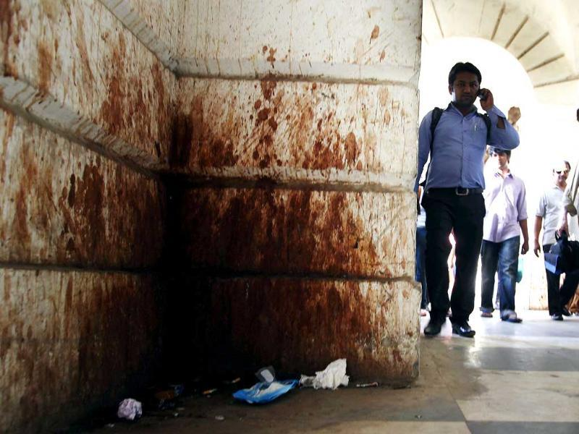
Red Spots
Red Spots are those areas where walls and roads of residential and commercial areas get stained red due to the constant spitting of Gutka/Paan/Tobacco by the local residents, travelers, or passerbys.

Slide 31
1.4
No visible solid waste in and zero encroachment around -
Storm Water Drains/Nallah *
Water bodies* (not limited to ponds, lakes, tanks, rivers etc.)
Marks
75
(50+25)
Storm Water Drains/Nallahs | Marks – 50
100% Storm water drains/Nallah (Secondary/Tertiary) should have screens/filters at a suitable distance: At points of discharge into other water-bodies For cities with more than 10 Lakh population: Automated/Mechanical screens on Secondary Nallahs for collection and cleaning of waste | 10
No solid waste floating/visible in 100% of the areas | 10
Boundary existing around all Storm water drains/Nallah should be well maintained | 10
No encroachment around storm water drains/Nallah | 10
No sewage/septic tank effluent discharged/disposed | 10
Water Bodies | Marks – 25
No solid waste floating/visible in 100% of area | 5
No open dumpsites present near the water bodies | 5
Sweeping & Cleaning arrangements are in place & No Garbage Vulnerable Points(GVP) present near water bodies | 5
Adequate twin-litterbins placed in every 50 meters of water bodies & Placement of Anti-littering message every 50 meters | 5
No sewage/septic tank effluent discharged/disposed | 5

Slide 32
Key definitions/notes
Storm water drains/nallahs are designed to drain excess rain and ground water from impervious surfaces such as paved streets, car parks, parking lots, footpaths, sidewalks, and roofs. They vary in design from small residential dry wells to large municipal systems. ULBs are expected to ensure that storm water drains are not choked with solid waste for free flow of the water.
Water bodies (not limited to ponds, lakes, tanks, rivers etc.) are an integral part of eco-system and need to be protected from waste with scheduled cleaning and maintenance work.
There should be no encroachment around water bodies and storm water drains/nallahs
Assessment of litter bin in every 50 meters of water body will be limited to the places where public pathway is there or accessible for the public.
1.4 Validation Methodology – Direct observation by the assessor.

Slide 33
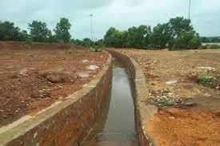
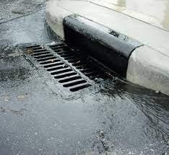
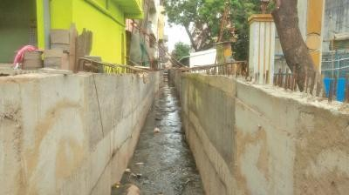
STORM WATER
DRAIN (SWD)
Storm Water Drains are closed conduits or open channels that receive runoff (rainwater) and convey the run-off (rainwater) to some point.

Slide 34
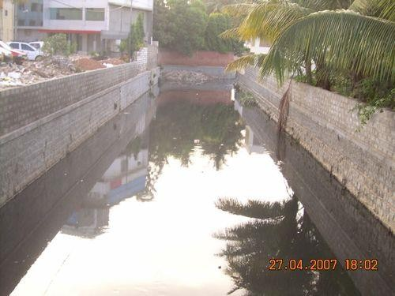
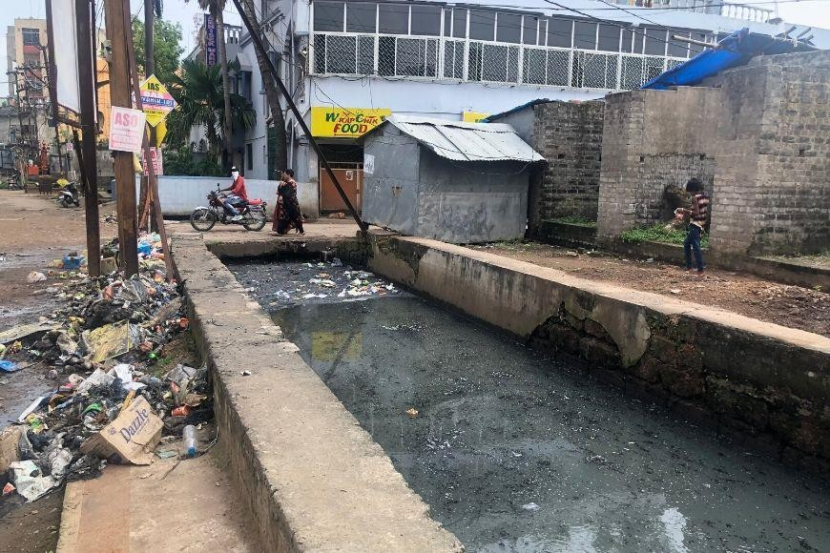
Photograph of SWD with no visible/floating solids
Photograph of SWD with visible/floating solids

Slide 35
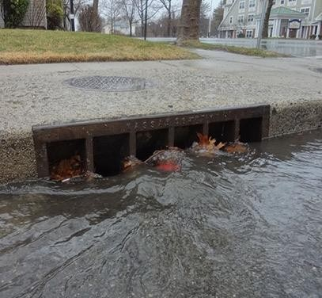
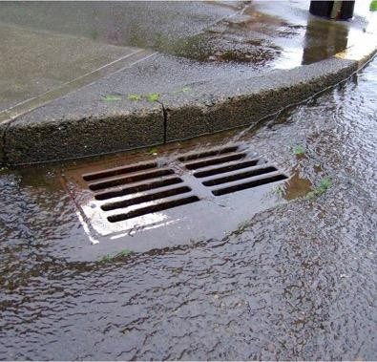
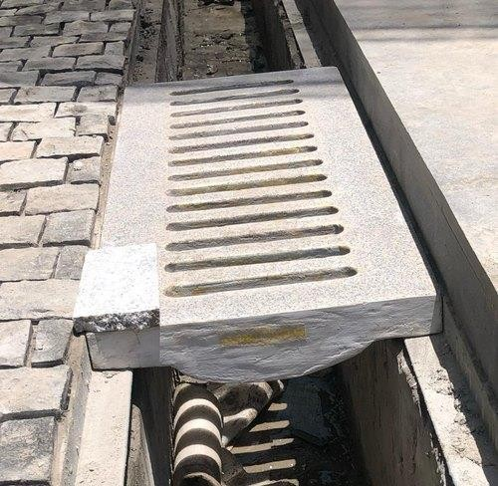
Photograph screens on Storm Water Drains

Slide 36
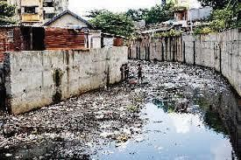
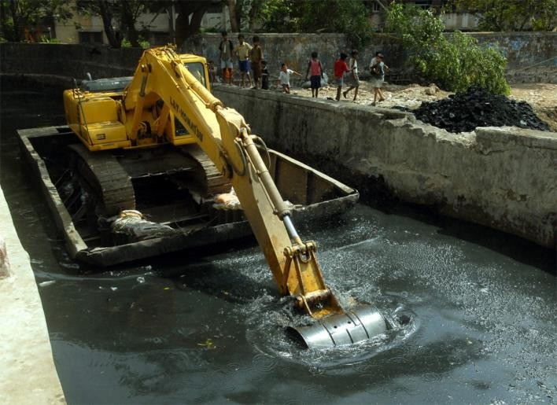
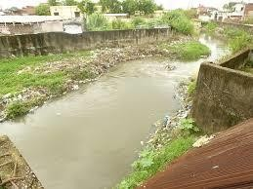
NALLAHS
A nallah is a natural drain that exists due to the topography of the terrain.

Slide 37
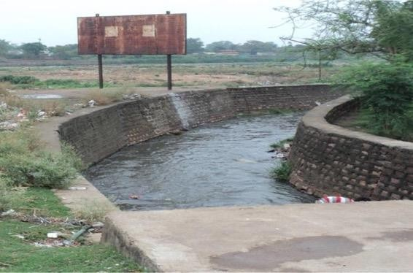
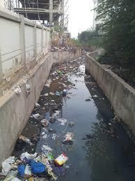
Photograph of nallah with no visible/floating solids
Photograph of nallah with visible/floating solids
Boundary wall
Nallah Without Solid Waste Floating
Nallah With Solid Waste Floating

Slide 38
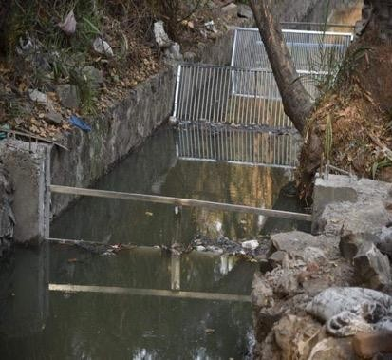
Photograph screens on Nallahs

Slide 39
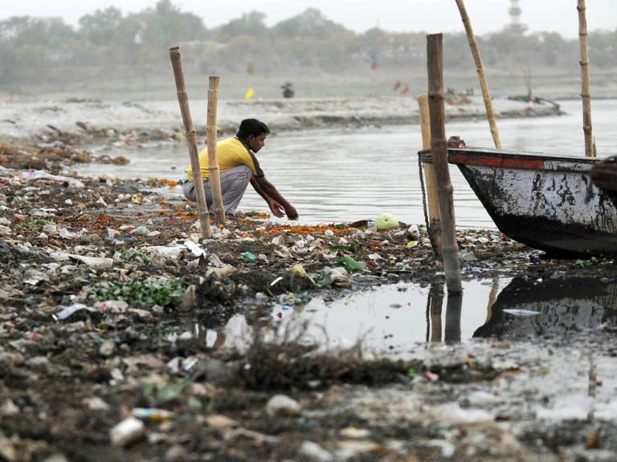
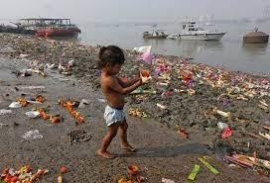
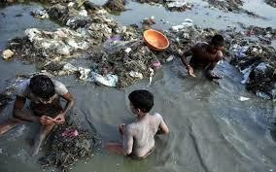
WATER BODIES
Water bodies include lakes, ponds, rivers, tanks, etc.

Slide 40
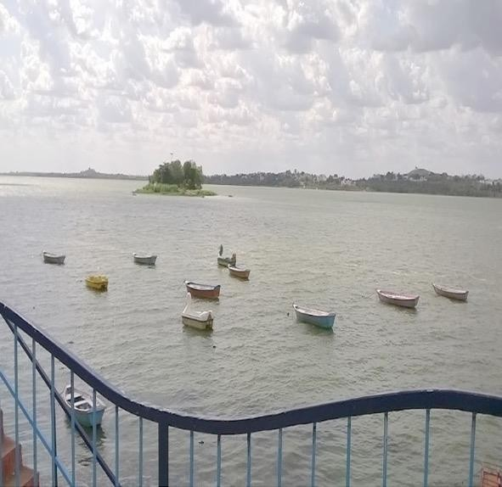
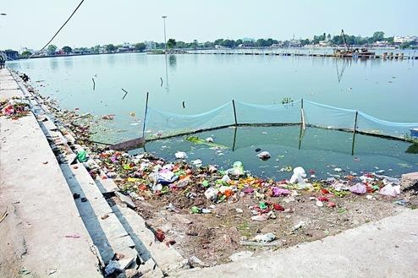
Photograph of water body with visible/floating solids
Photograph of water body with no visible/floating solids

Slide 41
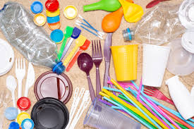
1.5
Ban on Single Use Plastic
Marks
150
Scheme of Marking | Marks
Ban notified | 30
Ban notification enforced and fine collected | 40
At least 1 processing facility set up for Plastic Waste processing (MRF, SLRM etc.) | 80
Banned

Slide 42
Key definitions/notes
Single-use plastics, or daily disposable plastics, are used only once before they are thrown away or recycled. These items include plastic bags, straws, coffee stirrers, plates, cups, glasses, spoons, Styrofoam used for hoardings etc.
This indicator would assess the extent of enforcement for discouraging one time use ‘Plastic’ in the city.
Considering the environmental degradation caused by one-time use plastics, cities should work towards discouraging its citizens from using single-use plastics.
1.5 Validation Methodology
Assessors will visit residential and commercial areas and carry out random citizen validation and direct observation

Slide 43
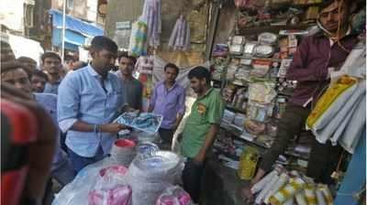

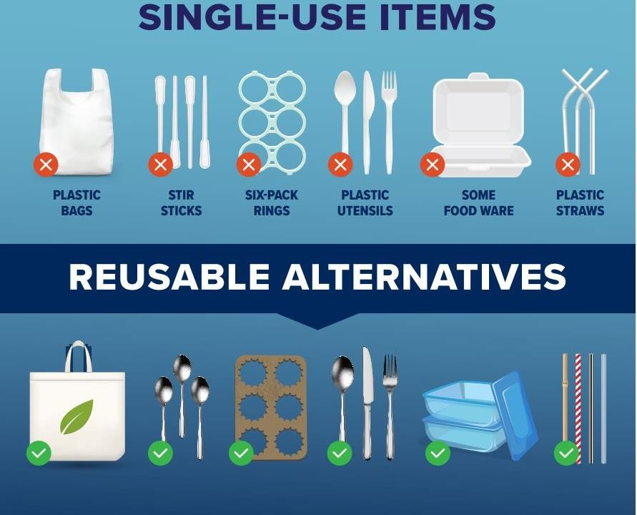
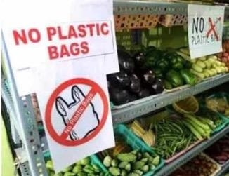
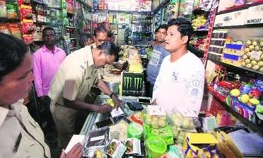
Any plastic bags, straws, coffee stirrers, plates, cups, glasses, spoons, Styrofoam (Single Use Plastics or Daily disposable Plastics) being used in Residential or Commercial Areas.
Assessor will observe whether Single Use Plastics or Daily disposable Plastics are being used or not

Slide 44
1.6
Promotion of Reduce Reuse Recycle (RRR)
Maximum score: 80
S. No. | Indicator | Marks
1 | Awareness of citizens about the RRR center in their ULB | 20
2 | Collection mechanism for sourcing in RRR center | 20
3 | At least 1 permanent RRR center in the ULB | 20
4 | Forward linkages established for disposal, reuse, recycling, repair of items collected | 20

Slide 45
1.6 Validation Methodology
The complete address along with geolocation of the permanent RRR center to be uploaded on Swachhatam Portal.
Direct observation of the RRR center in the ULB by the Assessor.
Citizen validation by the Assessor about awareness regarding RRR centers.

Slide 46
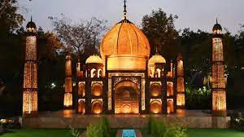


1.7
Waste to Wonder Park: ULBs to develop ‘waste to wonder’ park and/or installation of ‘waste to art’ sculptures
Marks
100
Scheme of Marking | Marks
At least one park developed as ‘Waste to Wonder’ park or ‘waste to art’ sculptures installed in at least one location within the ULB and geotagged picture uploaded on the Swachhatam Portal (IEC module) | 100

Slide 47
1.7 Validation Methodology
In ULBs/Wards/Areas where there is lack of space and/or prohibition orders for constructing a park cities can install sculptures from waste material at any location within the ULB
Direct observation by the Assessor.
The address along with geotagged picture of Waste to Wonder park or Waste to Wonder sculpture to be uploaded on Swachhatam Portal.

Slide 48



1.8
Zero Waste Events/Weddings/Social or Religious Functions : City/citizen is/are expected to manage at least ONE Zero Waste Functions in each month between October 2022-June 2023 with zero waste coming out of the Venue.
Marks
90
Note: All events should be conducted as per the SOP for zero waste event available on the Swachhatam Portal
Scheme of Marking | Marks
At least one Government program conducted as zero waste event | 20
At least one Social/Religious program conducted as zero waste event | 20
At least one Social Campaign conducted as zero waste event | 20
At least one awareness campaign regarding zero waste events in the ULB | 30
Note:
Zero Waste Events/Functions claim to be documented with pictures and other details to justify zero waste event
*Also applicable for functions held in premises owned by ULB’s
Validation Methodology-Document validation by the Assessor

Slide 49
1.9
Promoting youth participation – Swachh Tulip
(for ULBs with >1Lakh population*)
Maximum score: 75
The Urban Learning Internship Programme
The youth (graduates and above by qualification) can be engaged as interns by the ULBs and the State departments for supporting implementation of campaigns, citizen centric behavior change and IEC initiatives, monitoring of sanitation and waste management facilities, grievance redressal, adoption of IT solutions or other fields as defined by the ULB, falling under the mandate of the Mission.
For ULBs with <1 Lakh population who have inducted at least 1 Tulip intern will get full marks in this indicator, for those ULBs(<1Lakh) who have not inducted Tulip interns, the assessment will be done as per indicator 1.10B
S. No. | Population category of ULB | Criteria
1 | 1 lakh- 3 lakh | At least 3 interns
2 | 3 lakh-10 lakh | At least 5 interns
3 | >10 lakh | At least 7 interns

Slide 50
Key definitions/notes
The Swachh TULIP initiative was launched by MoHUA in September 2022 as a key initiative for encouraging youth participation and human resource augmentation at the ULB level for programmatic interventions planned under SBM-U 2.0.
The details on the program along with the key modalities for engaging students can be referred to using the Swachh TULIP guidelines.
An internship will be considered valid and eligible for SS2023 assessment only if each intern is engaged for a period of minimum of 2 weeks (e.g.- for a campaign or IEC initiative). The interns can also be engaged for longer durations depending on the ULB’s requirements.
1.9 Validation Methodology
Internship offer letter issued by the ULB and accepted by students on the AICTE internship portal before 15th July 2023.

Slide 51
1.10A
Benefits to workers
(only for ULBs with >1Lakh population)
Maximum score: 130
Benefits extended to sanitary workers and informal waste pickers.
S. No. | Scheme of marking | Sanitary workers | Informal waste pickers
1 | PPE kits given; old non-usable kit replaced | 20 | 20
2 | Linkages established with at least three eligible Government Schemes (linkage with Health scheme and Annual health Check-up is mandatory for Sanitary workers and with Health, Insurance & Education schemes for informal waste pickers) | 20 | 20
3 | Monthly recognition of best performing workers in each Ward | 10 | -
4 | Complete details of all sanitary workers and informal waste pickers updated in Swachhatam Portal MIS | 10 | 10
5 | Identity Card issued to informal waste pickers | - | 20
The above marking scheme will also be followed for those <1Lakh population ULBs who have scored full marks in indicator 1.9

Slide 52
1.10B
Benefits to workers
(only for ULBs with <1Lakh population who have NOT scored marks in indicator 1.9)
Maximum score: 205
Benefits extended to sanitary workers and informal waste pickers.
S. No. | Scheme of marking | Sanitary workers | Informal waste pickers
1 | PPE kits given; old non-usable kit replaced | 30 | 30
2 | Linkages established with at least three eligible Government Schemes (linkage with Health scheme and Annual health Check-up is mandatory for Sanitary workers and with Health, Insurance & Education schemes for informal waste pickers) | 30 | 30
3 | Monthly recognition of best performing workers in each Ward | 15 | -
4 | Complete details of all sanitary workers and informal waste pickers updated in Swachhatam Portal MIS | 20 | 20
5 | Identity Card issued to informal waste pickers | - | 30

Slide 53
1.10 Validation Methodology
Based on details provided by the ULB in Swachhatam MIS, Sanitary workers and informal waste pickers are called to enquire about availability of PPE, recognition, integration with schemes, etc. for validation.
Key definitions/notes
Female sanitation workers to be linked to schemes which specifically focus on women’s welfare. Suggested themes that must be focused on include women’s health such as Janani Shishu Suraksha Karyakaram (JSSK) focusing on the health of pregnant women and newborns and financial empowerment such as the Rashtriya Mahila Kosh. Any other state identified or sponsored schemes that focus on women’s welfare may be considered for this inclusion.
Schemes for the third gender (such as Garima Greh (in Gujarat), Sweekruti Scheme by Odisha govt) may also be considered as part of this indicators.

Slide 54
Key definitions/notes
For monthly recognition of best performing workers, one Male and one Female worker to be recognized in each Ward.
Provision of personal protection equipment (PPE) - including new uniform , fluorescent jacket, hand gloves, raincoats, appropriate footwear and masks, to all workers handling solid waste. New pair of gloves to be given once old pairs are unusable.
SWM Rules 2016 mandates provision of Personal Protective Equipment(PPE) to all workers involved in handling solid waste (engaged under Jaagirdari, SHG, NGO, private Agency, regular/casual workers etc.).
Wrong/no contact details of the worker would lead to non-compliance/non-performance.
Informal workers to be integrated with private contractors working with ULB, entrepreneurship opportunities either through convergence or providing soft loans through NSKFDC or under any other scheme.
Name of each scheme linkage facilitated by the ULB for each individual needs to be provided in the MIS portal.

Slide 55
2. PROCESSING & DISPOSAL
40%
Processing & Disposal
1,910 Marks
33%
Segregated Collection
1,600 Marks
27%
UWM &
Safaimitra Suraksha
1,320 Marks
Total Number of Indicators: 11
1,910 Marks / 4,830 Marks

Slide 56
Summary – Section 2
No. | Indicator | Marks
2.1 | Wet waste processing capacity of the ULB | 155
2.2 | Wet waste processing percentage of the ULB | 280
2.3 | Dry waste processing capacity of the ULB | 155
2.4 | Dry waste processing percentage of the ULB | 280
2.5 | Treatment of Sanitary and DHW in the ULB | 130
2.6 | C&D Waste Management | 120
2.7 | Is the landfill in ULB a sanitary landfill | 150
2.8 | Percentage of waste sent to sanitary landfill | 160
2.9 | Remediation of legacy waste dumpsites | 230
2.10 | Onsite wet waste processing by Bulk Waste Generators (BWG) | 100
2.11 | Collection & Transportation cost recovery through user charges | 150
 | Total (Processing & Disposal) | 1,910

Slide 57




2.1
Percentage of Wet waste processing capacity of functional plants (out of the total wet waste generated**)
Marks
155
The indicator would assess whether a city has adequate facility/infrastructure to process the wet waste collected. City will provide the actual waste collection figure where door to door collection is in place.
Processing capacity of functional plants | Marks
100% | 155
At least 80% | 125
At least 60% | 75
< 60% | 0
** Bulk waste generators or non-bulk waste generators managing on-site processing of the wet waste are not included (except cities with <1L population)
Geo coordinates (GIS details) in terms of ULB boundaries, ward number, ward boundaries, landmark etc of all Wet Waste Processing Plants to be mapped and updated on SBM portal as per the prescribed details (to be given by MoHUA) to qualify for marks

Slide 58





Percentage of wet waste being processed out of total wet waste generated and finished products (output) further sold.
(ULBs are encouraged to engage Women/SHGs/Transgenders in waste processing facilities)
Marks
280
(220+60)
2.2
This indicator assesses the extent of decentralized and centralized processing of wet waste collected. The amount of wet waste being sent to the landfill should be minimized. Records are maintained for quantity of wet waste received, processed, disposed at landfill and revenue generated by sale of finished products (from wet waste). Finished products consumed/absorbed by the ULB will be considered as revenue generated besides actual sale of the finished products. The revenue (self-consumption) will be calculated on the basis of commercial rate that ULB charges for supplying/selling compost/methane.
Processing of Wet Waste
Scheme of Marking | Marks
100% | 220
At least 90% | 160
At least 70% | 120
At least 50% | 75
< 50% | 0
Monthly Sale of finished products
Scheme of Marking | Marks
>75% finished product(s) sold/Consumed | 60
>50% finished product(s) sold/consumed | 30

Slide 59
2.1 & 2.2 Validation Methodology
Direct Observation
To ascertain the progress, the assessor will interact with the officials in the plant. The assessor will check the electricity bill and monitor other activities in the plant to ascertain the functionality of the plant.
He will also check the output/sent to dumpsite (including process rejects) on the basis of the input received (10% variation acceptable)
On the basis of observation and verification of log book and electricity bills Senior assessors at the back end will arrive at the efficiency level of the plant(s) and indicator wise marks will be given. The agency may further seek clarification from the ULB by asking documents maintained by the ULB.
In case of sale of finished products /used by the horticulture or other departments, sale receipts required - free distribution is not encouraged (e.g. farmers/citizens)

Slide 60

WASTE TO
COMPOSTING PLANTS
Composting is a process of controlled decomposition of the organic waste, typically in aerobic conditions, resulting in the production of stable humus-like product, i.e., compost
Composting Technologies:
windrow composting
aerated static pile composting
in-vessel composting
decentralised composting (bin and box composting)
vermicomposting.
‒

Slide 61




COMPOSTING TECHNOLOGIES
Windrow Composting
Aerated Stack Pile Composting
Box Composting
Vermi Composting
Pit Composting

Slide 62




Composting Facility
Signage
Wet-waste Collection Area
Composting Facility
Compost
Compost Sale Receipt
Log book Electricity Bill
A composting Facility will have the above given components which shall be assessed by the on field assessor

Slide 63



Photograph of Composting facility
Photograph of crate composting facility
© Ipsos 2022 - All rights reserved. Contains Ipsos' Confidential and Proprietary information and ma
© Ipsos | 21-099063-01_SSU2022-MoHUA | ToT Presentation | February 2022 | Version 1 | Client
y no and
t be disclosed or reproduced without the prior written consent of Ipsos..”
Internal use only

Slide 64


Composting Facilities

Slide 65


BIO-METHANATION PLANTS
Bio-methanation is the anaerobic (in the absence of free oxygen) fermentation of biodegradable matter in an enclosed space under controlled conditions of temperature, moisture, pH, etc.

Slide 66






Biogas Plants
© Ipsos 2022 - All rights reserved. Contains Ipsos' Confidenti
© Ipsos | 21-099063-01_SSU2022-MoHUA | ToT Presentati
al an on | F
d Proprietary information and may not be disclosed or reproduced without the pr
ebruary 2022 | Version 1 | Client and Internal use only
ior wri
tten consent of Ipsos..”
100

Slide 67




2.3
Whether capacity of dry waste processing facility/facilities in the city is matching with the total dry waste generated in the city?
Marks
155
The indicator would assess whether a city has adequate facility/infrastructure to process the total dry waste generated.
Processing capacity of functional plants | Marks
100% | 155
At least 80% | 125
At least 60% | 75
< 60% | 0
Geo coordinates (GIS details) in terms of ULB boundaries, ward number, ward boundaries, landmark etc of all Dry Waste Processing Plants to be mapped and updated on SBM portal as per the prescribed details (to be given by MoHUA) to qualify for marks

Slide 68




2.4
Linearity to Circularity
Marks
280
Dry waste being processed out of total dry waste generated (excluding sanitary and domestic hazardous waste) through MRF, RDF or Waste To Energy plants etc. (ULBs are encouraged to engage Informal Waste Pickers/Women/SHGs/Transgenders in MRF Centres)
This indicator assesses the extent of decentralized and centralized management of dry waste generated. Is the dry waste of the city being recycled or reused? Dry waste sold to cement plants, used for road construction and other use of non-recyclable dry waste should be explained. ULBs need to ensure that in MRFs – (a) Dry Waste is further segregated (b) Recyclables are sold to recyclers or scrap dealers, and (c) Records are maintained for quantity of waste received, segregated, recycled/ processed, sold, disposed at landfill and revenue generated by sale of recyclables (dry waste directly collected by scrap dealers or informal workers)
Scheme of Marking | Marks
At least 95% | 280
At least 90% | 200
At least 70% | 150
At least 50% | 75
< 50% | 0
Note: Recyclables sold to be documented in terms of revenue generated and details of buyers for validation.
Non-recyclables sent to the cement factory will also be considered under processing. Informal Waste Pickers, if available should be given first right to collect & sell recyclables – Receipts can be documented.

Slide 69



2.5
Percentage of total sanitary and domestic hazardous waste (*menstrual waste and baby/adult diapers and others**) generated is treated, either by ULB or through third party managing bio-medical waste. Hazardous waste from Hospitals, Nursing homes/clinics/Labs etc. not considered.
Cluster infrastructure within 50 km shall be considered.
Marks
130
Scheme of Marking | Marks
At least 90% | 130
At least 75% | 100
At least 50% | 60
At least 25% | 40
< 25% | 0
*to be processed through incineration process
**Discarded paint drums, pesticide cans, CFL bulbs, tube lights, expired medicines, broken mercury thermometers, used batteries, used needles and syringes and contaminated gauge, etc., generated at the household level – to be given to authorized recyclers

Slide 70
2.3
2.4
&
2.5
Whether capacity of dry waste processing facility/facilities in the city is matching with the total dry waste generated in the city?
Dry waste being processed out of total dry waste generated (excluding sanitary and domestic hazardous waste) through MRF, RDF or Waste To Energy plants etc.
Percentage of total sanitary and domestic hazardous waste (menstrual waste and baby/adult diapers and others*) generated is treated, either by ULB or through third party managing bio-medical waste. Hazardous waste from Hospitals, Nursing homes/clinics/Labs etc. not considered.
Methodology for Validation
The assessor will visit all plant(s)/processing facilities updated in the MIS.
To ascertain the progress, the assessor will also interact with the officials in the plant
The assessor will ask for the electricity bill and see other activities in the plant to verify the functionality of the facility. The assessor will also see if any hazardous waste is dumped/stored within the facility – should be treated separately.
On the basis of observation and verification of log book and electricity bills Senior assessors at the back end will arrive at the efficiency level of the plant(s) and indicator wise marks will be given.
100%
Direct
Observation

Slide 71
2.3, 2.4, 2.5 Validation Methodology
Direct Observation
To ascertain the progress, the assessor will interact with the officials in the plant. The assessor will check the electricity bill and monitor other activities in the plant to ascertain the functionality of the plant.
He will also check the output/sent to dumpsite (including process rejects) on the basis of the input received (10% variation acceptable)
On the basis of observation and verification of log book and electricity bills Senior assessors at the back end will arrive at the efficiency level of the plant(s) and indicator wise marks will be given. The agency may further seek clarification from the ULB by asking documents maintained by the ULB.
In case of sale of finished products /used by the horticulture or other departments, sale receipts required - free distribution is not encouraged (e.g. farmers/citizens)

Slide 72



MATERIAL RECOVERY
FACILITY (MRF)
A facility where non-combustible solid waste can be temporarily stored by the urban local body or any person authorized by the urban local body to facilitate segregation, sorting and recovery of various components of waste by informal sector of waste pickers or any other work force engaged for the purpose before the waste is delivered or taken up for its processing or disposal.

Slide 73




Material Recovery Facility (MRF)
Material Recovery Facility
Compartments for dry waste
Compartments for dry waste
Compartments for dry waste
© Ip
105 ‒© Ip
sos 2022 - All rights reserved. Contains Ipsos' Confidential and Proprietary information
sos | 21-099063-01_SSU2022-MoHUA | ToT Presentation | February 2022 | Version 1
and may not be dis
| Client and Interna
closed or reproduced without the prior written consent of Ipsos..”
l use only

Slide 74



RDF(REFUSED DERIVED
FUEL) PLANTS
Segregated combustible fraction of solid waste other than chlorinated plastics in the form of pellets or fluff produced by drying, shredding, dehydrating and compacting combustible components of solid waste that can be used as fuel.

Slide 75






RDF
Waste collection & Segregation
RDF Briquette Machine
RDF
Waste Shredder
RDF Briquette
RDF
© Ipsos 2022 - All rights reserved. Contains Ipsos' Confidential an
© Ipsos | 21-099063-01_SSU2022-MoHUA | ToT Presentation | F
d P ebru
roprietary information and may not be disclosed or reproduced without the pr
ary 2022 | Version 1 | Client and Internal use only
ior w
ritten consent of Ipsos..”

Slide 76


SLRM CENTRES
Solid Liquid Resource Management (SLRM) centres

Slide 77


WASTE TO
ENERGY(WtE) PLANTS
Waste To Energy (WtE) refers to the process of generating energy in the form of heat or
electricity from municipal solid waste.

Slide 78




WtE Plants
Waste storage in the plant
Conveyor belt
Dry waste segregation
ary information and may not be disclosed or reproduced w
022 | Version 1 | Client and Internal use only

Slide 79

SANITARY & DOMESTIC
HAZARDOUS WASTE (DHW) PLANTS
Sanitary Waste:
  Wastes comprising of used diapers, sanitary towels or napkins, tampons, condoms, incontinence sheets and any other similar waste.
Domestic Hazardous Waste (DHW):
  Domestic hazardous waste comprises of any solid waste or a combination of solid wastes that requires special handling and disposal as it harmful to human health and environment.
E.g. Discarded paint drums, pesticide cans, CFL bulbs, tube lights, expired medicines, broken mercury thermometers, used batteries, used needles and syringes and contaminated gauge.

Slide 80




Domestic Hazardous Waste (DHW)
Protected & isolated area
Incinerator
Storage area
Incinerator
2022 - All rights reserved. Contains Ipsos' Confidential and Proprietary information and ma
| 21-099063-01_SSU2022-MoHUA | ToT Presentation | February 2022 | Version 1 | Client
sclosed or reproduced without the prior written consent of Ipsos..”
al use only

Slide 81
2.6
C&D waste management
(MoHUA Non-NCAP ULBs)
Marks 120
Scheme of Marking | Total Marks 120
Availability of Mobile collection unit for citizens. (on call basis C&D waste collection facility) | 30
Designated collection points duly geo-tagged within reasonable distance for C&D waste generator to bring and deposit | 30
Notification of charges (including in-built charges at the time of permission for construction) for Collection & Transportation and Processing & Disposal of C&D Waste notified and enforced | 30
Campaign conducted to promote C&D waste collection from household or site for processing. | 30

Slide 82
2.6
C&D waste management
(MoHUA NCAP ULBs)
Marks 120
Scheme of Marking | Total Marks 60
Mobile collection unit for citizens. (on call basis C&D waste collection facility - weekly schedule) available along with designated collection points duly geo-tagged within reasonable distance for C&D waste generator to bring and deposit | 25
Notification of charges (including in-built charges at the time of permission for construction) for Collection & Transportation and Processing & Disposal of C&D Waste notified and enforced | 20
Are the citizens aware that C&D waste can be collected from their household or site for processing. | 15
Processing and selling of C&D waste collected from non-bulk and bulk generators (within city or at a cluster level) | Total Marks 60
>50% C&D waste either processed in the facility by making products or raw-material re-used – sold (with sale receipt) | 60
40% -50% C&D waste either processed in the facility by making products or raw-material re-used – sold (with sale receipt) | 50
30% -39% C&D waste either processed in the facility by making products or raw-material re-used – sold (with sale receipt) | 40
20% -29% C&D waste either processed in the facility by making products or raw-material re-used – sold (with sale receipt) | 30
10% -19% C&D waste either processed in the facility by making products or raw-material re-used – sold (with sale receipt) | 20
<10% C&D waste either processed in the facility by making products or raw-material re-used – sold (with sale receipt) | 0

Slide 83
2.6 Validation Methodology
The assessor will visit collections points and all plant(s) and processing facilities updated in the MIS.
To ascertain the progress, the assessor will also interact with the officials in the plant
The assessor will ask for the electricity bill and see other activities in the collection centre/ processing plant to verify the functionality of the facility.
Assessor will also observe if C&D waste is kept segregated in 5 categories
On the basis of observation and verification of log book/electricity bills Senior assessors at the back end will arrive at the efficiency level of the plant(s) and sub-indicator wise marks will be given.

Slide 84



C&D WASTE
Construction and Demolition Waste:
Cement and concrete, bricks, cement plaster, steel (from reinforced concrete, door or window frames, roofing support, railings of staircase, etc.), rubble, stone, timber or wood Minor components. pipes (GI, iron, plastic, panels (wooden, laminated), glazed tiles, glass panes, etc.

Slide 85


C&D WASTE COLLECTION CENTRE

Slide 86


C&D WASTE PROCESSING PLANT

Slide 87






C&D Waste Plant
Weigh Station
Crushed bricks
C&D Waste Processing
Facility
Weigh Station
Segregated C&D waste
Concrete blocks
© Ipsos 2022 - All rights reserved. Contains Ipsos' Confid
© Ipsos | 21-099063-01_SSU2022-MoHUA | ToT Present
ent ati
ial and Proprietary information and may not be disclosed or reproduced without the prior writte
on | February 2022 | Version 1 | Client and Internal use only
n
consent of Ipsos..”
138

Slide 88

2.7A
Is the landfill in the city a sanitary landfill?
(ULBs with >1 Lakh population)
Marks
150
WHY
This parameter assesses whether the landfill site of the ULB is scientific/ planned in nature or in accordance with SWM 2016 rules. Inerts can be used in low lying areas, road construction etc.
Scheme of Marking | Marks
Sanitary landfill available and being used / Zero landfill | 150
Landfill is required but not available/functional | 0
Geo coordinates (GIS details) in terms of ULB boundaries, ward number, ward boundaries, landmark etc of all Sanitary Landfills to be mapped and updated on SBM portal as per the prescribed details (to be given by MoHUA) to qualify for marks.

Slide 89
2.7 B
Is the landfill in the city a sanitary landfill?
(ULBs with <1 Lakh population)
Marks
150
WHY
This parameter assesses whether the landfill site of the ULB is scientific/ planned in nature or in accordance with SWM 2016 rules. Inerts can be used in low lying areas, road construction etc.
Scheme of Marking | Marks
Sanitary landfill available and being used / Zero landfill | 150
OR
Action Plan submitted on Swachhatam portal and approved by MoHUA for Sanitary Landfill | 75
Tender published | 75
Geo coordinates (GIS details) in terms of ULB boundaries, ward number, ward boundaries, landmark etc of all Sanitary Landfills to be mapped and updated on SBM portal as per the prescribed details (to be given by MoHUA) to qualify for marks.

Slide 90
2.7
Is the landfill in the city a sanitary landfill?
Methodology for Validation
The assessor will visit the landfill site(s) to check if the landfill is a sanitary landfill
100% Direct
Observation

Slide 91
DIFFERENCE BETWEEN DUMPSITE AND LANDFILL
Feature | Dumpsite | Sanitary Landfill (also known as Landfill)
Leachate collection | Not done | Done in a collection well
Methane production | Not tapped | Collected
Geo-textile layer | Absent | Present

Slide 92
2.8
Percent (%) of total waste generated (process rejects/unprocessed) going to the sanitary landfill
Marks
160
(150+10)
City has to make sure that all waste generated should be processed. Only process rejects should go to the sanitary landfill. Unprocessed waste should only be sent to the sanitary landfill if city doesn’t have processing capacity matching the total wet/dry waste collected.
Scheme of Marking | Marks
Not more than 10% | 150
Not more than 15% | 100
Not more than 25% | 50
Not more than 45% | 25
> 45% | 0
Geo coordinates (GIS details) in terms of ULB boundaries, ward number, ward boundaries, landmark etc of all Sanitary Landfills to be mapped and updated on SBM portal as per the prescribed details (to be given by MoHUA) to qualify for marks
10
Marks

Slide 93
2.8
Percent (%) of total waste generated (process rejects/unprocessed) going to the sanitary landfill
Methodology
for Validation
The assessor will visit the sanitary landfill site(s) as updated in the MIS.
To ascertain the progress, the assessor will also interact with the officials on the site
ULB will have log-book/register capturing at least last 3 month’s record ready and available for the agency to check the daily entry of the trucks (with waste load) entered inside the site
He will report the progress verified basis documents provided by the ULB to the agency.
The senior assessor will also derive the total waste generated Vs processed in the city and try to reconcile the waste sent daily to the landfill
100% Direct Observation

Slide 94



SANITARY LANDFILL
The final and safe disposal of residual solid waste and inert wastes on land in a facility designed with protective measures against pollution of ground water, surface water and fugitive air dust, wind-blown litter, bad odour, fire hazard, animal menace, bird menace, pests or rodents, greenhouse gas emissions, persistent organic pollutants slope instability and erosion.

Slide 95


LEACHATE COLLECTION SYSTEM

Slide 96


Sanitary Landfill
Leachate Collection Well
Leachate Collection Well

Slide 97
2.9
Remediation of all identified dumpsites
Marks
230
(170+50+10)
Condition | Marks
Legacy Waste Dumpsites Remediation Action Plan (Module-2) submitted on Swachhatam Portal | 50
If Legacy waste is
less than 1 lakh ton
If Legacy waste is
between 1-2 lakh tons
Geo coordinates (GIS details) in terms of ULB boundaries, ward number, ward boundaries, landmark etc of all Dumpsites mapped and updated on SBM portal as per the prescribed details (given by MoHUA)
Work completed as per remediation action plan | Marks
25% | 100
50% | 130
75% | 150
90% | 170
Work completed as per remediation action plan | Marks
20% | 100
45% | 130
65% | 150
85% | 170
10
Marks
If Legacy waste is
between 2-5 lakh tons
If Legacy waste is
more than 5 lakh tons
Work completed as per remediation action plan | Marks
15% | 100
35% | 130
55% | 150
80% | 170
Work completed as per remediation action plan | Marks
10% | 100
25% | 130
50% | 150
75% | 170

Slide 98
2.9
Remediation of all identified dumpsites no legacy waste (dumpsite)/Zero landfill city
(Assessment benchmark: Progress made on the last progress claimed to be assessed – land recovered after January 2022. Marks will not be given on the same progress…..and already claimed in SS-2022)
Methodology for Validation
The assessor will visit the legacy dumpsite(s) in the city and check whether remediation work has completed as per the claim made by the city in the MIS. The reference point during the validation will the progress made from the progress claimed in SS-2022.
100% Direct
Observation

Slide 99
Legacy Waste Dumpsites Remediation Action Plan (Module- 2) to be submitted & approved by State Mission Director.

Slide 100



DUMPSITE
REMEDIATION

Slide 101



Remediation of Dumpsite
Remediation facility for Legacy waste
Remediation in process
Remediated site
Remediated site
sos 2022 - All rights reserved. Contains Ipsos' Confidential and Proprietary information and may not
sos | 21-099063-01_SSU2022-MoHUA | ToT Presentation | February 2022 | Version 1 | Client and I
duced without the prior written consent of Ipsos..”

Slide 102


2.10
Bulk Waste Generators (i) doing onsite processing of wet waste generated, including kitchen and garden waste or organic waste or getting wet waste collected and processed by private parties authorized by ULB. (ii) Handing over segregated dry waste to authorized waste pickers or waste collectors.
Marks
100
A BWG will be considered as one that generates more than 100 kg of total waste per day (or as defined by ULB/state) for more than 15 days a month
Community Hall/Function Hall/Marriage Hall/Public gathering waste generators shall be considered as BWG if the holding capacity is more than 200 pax
Scheme of Marking | Marks
100% | 100
At least 80% | 80
At least 60% | 60
<60% | 0
Note:
ULBs in <1 lakh population cities are allowed to process the waste of Bulk Waste Generators provided all Bulk Waste Generators are identified and commercial rates are charged
If city's population is >1 Lakh, ask BWGs for on-site processing or outsource processing to private operators
Geo coordinates (GIS details) in terms of ULB boundaries, ward number, ward boundaries, landmark etc of all Bulk Waste Generators to be mapped and updated on SBM portal as per the prescribed details (to be given by MoHUA) to qualify for marks

Slide 103
2.10
Bulk Waste Generators (i) doing onsite processing of wet waste generated, including kitchen and garden waste or organic waste or getting wet waste collected and processed by private parties authorized by ULB. (ii) Handing over segregated dry waste to authorized waste pickers or waste collectors.
Methodology for Validation
On-field assessor will randomly visit the housing societies/RWAs/vendors in wards claimed under on-site processing of wet waste – sample size will follow as per the population.
Question will be asked and personally observed if on-site processing being practiced
3.
On the basis of on-field verification, Independent Validation Matrix (IVM) will be applied and final
100% Direct Observation
marks given). Final marks = Marks claimed – marks adjusted as per IVM

Slide 104



BULK WASTE GENERATOR
(BWG) PROCESSING ON-SITE
As per Solid Waste Management Rules 2016, “Bulk Waste Generator” means and includes buildings occupied by the Central Government Departments or Undertakings, State Government Departments or Undertakings, Local Bodies, Public Sector Undertakings or Private Companies, Hospitals, Nursing Homes, Schools, Colleges, Universities, other Educational Institutions, Hostels, Hotels, Commercial Establishments, Markets, Places of Worship, Stadia and Sports Complexes etc having an average waste generation rate exceeding 100 kg per day (of all waste streams put together).
Organic waste composter

Slide 105






Bulk waste generator are those where,
Gathering >= 200 Pax, Waste generation >= 100 kg/day for more than 15 days a month
Wedding / Party hall
Commercial office
Educational Institute
Restaurant
Hostel
Hotel
© Ipsos 2022 - All rights reserved. Contains Ipsos' Confidential a
© Ipsos | 21-099063-01_SSU2022-MoHUA | ToT Presentation |
nd Pr
oprietary information and may not be disclosed or reproduced without the p
ary 2022 | Version 1 | Client and Internal use only
rior wr
itten consent of Ipsos..”
Febru
Hospital, railway station, Airport, Sport complex, Club, shopping mall, etc.

Slide 106



Pit composting
Drum composting
Onsite Bio-methanation

Slide 107



Khamba composting
Drum composting
Onsite Bio-methanation

Slide 108

What percentage of the operational cost (Collection & Transportation) of Solid Waste Management is covered by ONLY USER CHARGES (for SWM related services) collected directly or user charges collected through Property Tax/Water/Electricity Bill etc. ( SWM sub head)?
Salary expenses to Daily wagers, contractual or outsourced staff through service providers( against vacant posts) will be added along with cost
Expenses related to sweeping of public/commercial areas and expenses related to processing of waste & disposal are NOT covered.
2.11
Marks
150
To assess extent of cost recovery in solid waste management services
Note:
City should either maintain a detailed statement or Chartered Accountant’s certificate to support their claim.
In addition to quarterly performance, performance can also be assessed for total revenue collected till 31st December 2022 Vs cumulative operational cost incurred till 31st Dec 2022 – best performance will be applied when giving marks in the Ph-1 and Ph-2
Scheme of Marking | Marks
At least 60% of the cost | 150
At least 50% | 120
At least 40% | 90
At least 30% | 50
<30% | 0

Slide 109
3. UWM and Safaimitra Suraksha
40%
Processing & Disposal
1,910 Marks
33%
Segregated Collection
1,600 Marks
27%
UWM &
Safaimitra Suraksha
1,320 Marks
Total Number of Indicators: 8
1,320 Marks / 4,830 Marks

Slide 110
Summary
No. | Indicator | Marks
3.1 | Connection to sewerage, septic tank, twin pit, etc. | 50
3.2 | FSTP/STP capacity | 100
3.3 | Faecal sludge & sewage treatment & reuse | 170
3.4 | Cleanliness of CT, PT, Urinals & feedback | 250
3.5 | Safaimitra Suraksha – Core Parameters | 320
3.6 | Safaimitra Suraksha – Eco-system Parameters | 180
3.7 | Safaimitra Suraksha – IEC | 80
3.8 | Safaimitra Suraksha – Capacity Building & Empowerment | 170
 | Total (UWM & Safaimitra Suraksha) | 1,320
*In addition to the above, the agency may ask for any other relevant document for ascertaining appropriate marks eligibility of the ULB.

Slide 111


3.1
What percentage of Households, Commercial Institutions, Establishments and Public area CTs/PTs are connected to a closed system such as sewerage, septic tank + soak pit, twin-pit system etc. (no open system/connection/flow/discharge)
Marks
50
This indicator will ascertain whether the city has adequate coverage of sewerage network or septic tanks
Scheme of Marking | Marks
>95 % households/commercial establishment /CT&PT are connected to sewerage system or have septic tanks + Soak Pit | 50
80-94% households/commercial establishment / CT & PT with Sewerage/Septic tank + Soak Pit | 45
60-79% households/commercial establishment / CT & PT with Sewerage/Septic tank + Soak Pit | 35
< 40-60% households/commercial establishment / CT & PT with Sewerage/Septic tank + Soak Pit | 25
< 40% households/commercial establishment / CT & PT with Sewerage/Septic tank + Soak Pit | 10
Note: City to also confirm if areas where households are not connected to a closed system having sewerage system in place

Slide 112
3.1
What percentage of Households, Commercial Institutions, Establishments and Public area CTs/PTs are connected to a closed system such as sewerage, septic tank + soak pit, twin-pit system etc. (no open system/connection/flow/discharge)
Methodology for Validation
The on-field assessor will randomly visit the different parts of the city, as per coverage claimed, to
check if there is any open discharge
On the field observation, Independent Validation Matrix (IVM) will be applied and final marks given).
Final marks = Marks claimed – marks adjusted as per IVM
100% Direct Observation

Slide 113




Connected with septic tank (with no overflow) or with
sewer network - no open drainage/ No Open Discharge
Safe Disposal

Slide 114



3.2
Whether capacity* of FSTP and STP in the city is matching with the total faecal sludge and sewage which is collected/generated in the city?
* Capacity under cluster approach will be considered provided the distance upto 50 km from the city boundary
Marks
100
(90+10)
This indicator would assess whether the infrastructure to treat entire faecal sludge and sewage generated in the city is available or on cluster basis (upto 50 km)
Scheme of Marking | Marks
At least 70% capacity matching with total faecal sludge and sewage generated | 90
At least 50% | 80
At least 25% | 60
<25% | 0
Geo coordinates (GIS details) in terms of ULB boundaries, ward number, ward boundaries, landmark etc of all Wastewater treatment Plants (FSTP/STP) mapped and updated on SBM portal as per the prescribed details (given by MoHUA)
10
Marks

Slide 115



3.3
Linearity to Circularity
Marks
170
(115+55)
What percentage of faecal sludge collected or sewage generated from Households/Commercial Establishments/ CTs/PTs is treated at FSTP/STP - Scientific processing of faecal sludge and sewage - Whether treated used-water from STP reused/recycled and revenue generated ?
This indicator will ascertain whether majority of the faecal sludge and sewage in the city is being processed scientifically and not being discharged in the open – and whether city reuse/recycle the treated wastewater from STP/FSTP. Treated wastewater utilization and consequent revenue saved by using the treated used-water will be considered as revenue generated besides actual sale of the treated used-water. The revenue will be calculated on the basis of commercial rate that ULB charges for supplying/selling water.
Scheme of Marking - Treatment | Marks
At least 70% Faecal sludge/Sewage treated | 115
At least 50% | 80
At least 25% | 40
<25% | 0
Whether treated waste water is reused/recycled? (to reduce the burden on fresh water)
Scheme of Marking | Marks
>20% treated used-water is reused/recycled | 55
20% - 10% treated used-water is reused/recycled | 40
< 10% treated used-water is reused/recycled | 30
No treated used-water is reused/recycled | 0

Slide 116
3.2
&
3.3
Whether capacity* of FSTP /STP in city is matching with total faecal sludge and sewage which is collected?
* Capacity under cluster approach will be considered provided the distance upto 50 km from the city boundary
What percentage of faecal sludge collected from Households/Commercial Establishments/ CTs/PTs is treated at FSTP/STP - Scientific processing of faecal sludge and sewage - Whether treated usedwater from STP/FSTP reused/recycled?
As per Generation:
Designed Input Capacity of STP (In MLD) + Designed Input Capacity of FSTP (in KLD to be converted in MLD)
Estimated Quantity of sewage generated in Million litres per day (MLD) (can be taken as 80 % of water supplied) + Estimated quantity of septage to be de-sludged from these septic tanks (Faecal Sludge Generation)
As per Collection:
Quantity of sewage collected through sewers in MLD + Quantity of sewage received from drains in MLD+ quantity of sewage collected through sewers in MLD + Actual Quantity of septage desludged from septic tank with or without soakpits (Quantity available from record book / database) by (i) ULB (ii) Private Desludging Operators Registered with ULB (monthly)
Designed Input Capacity of STP (In MLD) + Designed Input Capacity of FSTP (in KLD to be converted in MLD)
On the basis of the list of the processing facilities/plants (STP/FSTP) updated by the ULB in the MIS, the assessor will
visit all plants
To ascertain the progress, the assessor will also interact with the officials in the plant
The assessor will ask for the log-book capturing at least last 3 month’s record and electricity bill to verify the
functionality of the facility
The assessor will also check if the treated usedwater is being re-used as claimed.
On the basis of observation and verification of log book/electricity bills Senior assessors at the back-end will arrive
at the efficiency level of the plant(s) and indicator wise marks will be given.
100% Direct
Observation
Methodology for Validation
Water reuse generally refers to the process of using treated wastewater (reclaimed water) for beneficial purposes such as agricultural and landscape irrigation, industrial processes, non-potable urban applications (such as toilet flushing, street washing, and fire protection), groundwater recharge, recreation, and direct or undirected water supply

Slide 117
SEWAGE TREATMENT PLANT
(STP) / FAECAL SLUDGE TREATMENT PLANT (FSTP)
Blackwater: Wastewater generated from toilets.
Grey water: Wastewater generated from bathing, kitchen and all other household activities except toilets. Sewage: Combined grey and black water generated from household.
Faecal Sludge : The accumulated semi-solid or solid portion that settled at the bottom of the septic tank which
comprises 20% - 50% of the total septic tank volume is termed as faecal sludge.

Slide 118




SEWAGE TREATMENT PLANT (STP)
- All rights reserved. Contains Ipsos' Confidential and Proprietary inf
be disclosed or reproduced without the prior written consent of Ipsos..”

Slide 119

TREATMENT TECHNOLOGIES USED
Waste Stabilisation Ponds (WSP)
Activated Sludge Process (ASP)
Extended Aeration Process (EAP)
Sequencing Batch Reactor (SBR)
Moving Bed Biological Reactor (MBBR)
Fluidized Aerated Bed (FAB)
Membrane Bioreactors (MBR)
Up flow anaerobic sludge blanket (UASB)
Phyto rid/Reedbed/Wetland Processes/DEWATS

Slide 120


FAECAL SLUDGE & SEPTAGE
MGT. (FSSM)
FSSM Value Chain
Process Flow Diagram of FSTP Facility
roprietary information and may not be disclosed or reproduced without the prior written consent of Ipsos..”
uary 2022 | Version 1 | Client and Internal use only

Slide 121



Sewage Treatment Plant (STP)
Pumping station
Screens
Decanting/Settling

Slide 122


Photograph of Signage of STP plant
Photograph of inlet sewage

Slide 123


Photograph of STP plant
Photograph of STP plant

Slide 124


Photograph of grit or sludge from STP
Photograph of outlet treated wastewater

Slide 125


Photograph of Test Report maintained at the plant
Photograph of Test certificate issued from CPCB/SPCB
© Ipsos 2022 - All rights reserved. Contains Ipsos' Confidential and Proprietary information and
© Ipsos | 21-099063-01_SSU2022-MoHUA | ToT Presentation | February 2022 | Version 1 | Cli
may ent a
not be disclosed or reproduced without the prior written consent of Ipsos..”
nd Internal use only

Slide 126


Photograph of logbook maintained at the plant
Photograph of electricity bill of STP plant
© Ipsos 2022 - All rights reserved. Contains Ipsos' Confidential and Proprietary information and may not be disclosed or reproduced without the prior written consent of Ipsos..”
© Ipsos | 21-099063-01_SSU2022-MoHUA | ToT Presentation | February 2022 | Version 1 | Client and Internal use only

Slide 127



Faecal Sludge Treatment Plant (FSTP)
Sump well/ MPS
FSTP Facility
Drying Bed
eproduced without the prior written consent of Ipsos..”
163

Slide 128


3.4
Are Public Toilets, Urinals and Community Toilets clean and user friendly - each performance indicator to be answered with either YES or NO.
Marks
250
(85+85+60+20)
This indicator would assess the functionality of the CT/PTs/Urinals in the city with number of features in place to ensure that the citizens are comfortable for using the toilet. Yes will get full marks and No will get zero marks provided for each sample.
Public Toilet (PT)
Community Toilet (CT)
Urinal
Scheme of Marking | Marks
Separate section for Men & Women | 10
Dry and clean | 10
Running water – Tap & Flush working | 10
Well lit – electric/natural light | 5
Functional bolting on all doors | 5
*Caretaker is present for maintenance | 5
Open between 6am – 10pm | 5
User friendly for differently able people | 30
Sanitary napkin dispensing system in place | 5
Scheme of Marking | Marks
Separate section for Men & Women | 10
Dry and clean | 10
Running water – Tap & Flush working | 10
Well lit – electric/natural light | 5
Functional bolting on all doors | 5
Institutional arrangements in place for maintenance/cleaning | 5
24 Hours Open | 5
User friendly for differently able people | 30
Sanitary napkin dispensing system in place | 5
Scheme of Marking5 | Marks
Dry and clean | 10
Running water for flushing | 10
Well lit – natural light and if covered – electric light | 5
Institutional arrangements in place for maintenance/cleaning | 5
User friendly for differently able people | 30
CTs & PTs prominently displaying SBM messages around usage of Public-Community Toilets, with Swachh Survekshan-2023 logo | 5 Marks
Feedback Mechanism in place in all Public, Community Toilets, Urinals & linked with SBM Portal | 10 Marks
*to motivate women to join the workforce and provide them with a secure livelihood opportunity, O&M by women SHG members and appointment of women/ third-gender caretakers for PTs is strongly encouraged (during day-shift only)
Geo coordinates (GIS details) in terms of ULB boundaries, ward number, ward boundaries, landmark etc of all CTs, PTs & Urinals mapped and updated on SBM portal as per the prescribed details (given by MoHUA)
5
Marks

Slide 129
3.4
Are Public Toilets, Urinals and Community Toilets clean and user friendly - each performance indicator to be answered with either YES or NO.
On the basis of the claim, the assessor will visit the selected CT/PT/Urinals as per sample to validate the claim made. He will also randomly talk to the citizens and ascertain whether citizens are satisfied with functionality of the Community/Public Toilets and Urinals
The assessor will only ask this question to citizens using Community/Public Toilets and Urinals
During on field validation, this question will be asked only to citizens seen using Community/Public toilets and urinals.
On the basis of observation and interaction with citizens/plant official, Independent Validation Matrix (IVM) will be applied and final marks given). Final marks = Marks claimed – marks adjusted as per IVM
Methodology for Validation
To be validated in Ph-3 also
100% Direct Observation

Slide 130



PUBLIC TOILET (PT)
Public toilets (PT) is a facility provided for the floating population / general public in places such as markets, train stations or other public areas.
Public Toilets have an official time which may vary city to city.(6 A.M. - 10 P.M.)

Slide 131



COMMUNITY TOILETS (CT)
Community toilets (CT) facility is a shared facility provided for a defined group of residents or an
entire settlement / community.
It is normally located in or near the community area and used by almost community members.

Slide 132


URINALS
A urinal is a sanitary plumbing fixture for urination only.

Slide 133


Separate section for men & women
NO separate section for men & women
© Ipsos 2022 - All rights reserved. Contains Ipsos' Confidential and Proprietary information and may not
isclosed or reproduced without the prior written consent of Ipsos..”

Slide 134



No bolting arrangement
Urinal not clean
Toilet floor is not clean
‒

Slide 135






Caretaker
Bolting arrangement
Running Water or flush
Lighting & Switches
User friendly for the differently abled
Running tap
© Ipsos 2022 - All rights reserved. Contains Ipsos' Confidential
© Ipsos | 21-099063-01_SSU2022-MoHUA | ToT Presentation |
and Pr Febru
oprietary information and may not be disclosed or reproduced without t
ary 2022 | Version 1 | Client and Internal use only

Slide 136

Photograph of community toilet
Photograph of SBM Message
Assessor will visit Public and Community toilets of the ULB to assess the presence of SBM Messaging and Feedback Mechanism present in the ULB
‒

Slide 137


Photograph of Public toilet
Photograph of SBM Message & toilet timing
© Ipsos 2022 - All rights reserved. Contains Ipsos' Confidential and Proprietary information and may
© Ipsos | 21-099063-01_SSU2022-MoHUA | ToT Presentation | February 2022 | Version 1 | Client a

Slide 138





750 Marks
Mandatory conditions to Claim 750 Marks under Safaimitra Suraksha Indicators
(i) RSA and SRU notified and operations and (ii) Valid ODF+ Certificate

Slide 139
3.5
Core Parameters
Machines & Workforce
320
Marks
3.6
Eco-system Parameters
Notification regarding Standardization of Septic Tank,
Hazardous sewer entry ban notified,
14420 complaints resolution
180
Marks
3.7
IEC
24X7 Helpline (to seek information, register complaint and track resolution status)
Public Awareness Campaigns
80
Marks
Capacity Building & Empowerment
Capacity Building (In-house/private trained desludging operators/staff – following CPHEEO Manual)
170
Marks
3.8
Total Marks
750

Slide 140

Sanitation Response Unit
Emergency Response Sanitation Unit

Slide 141

Emergency Response Sanitation Unit/
Sanitation Response Unit (SRU)
Emergency Response Sanitation Unit
Why Needed
Government of India is committed to ensure that no person needs to enter any sewer or septic tank, unless absolutely inescapable in interest of greater public hygiene.
More than 50% of households in Urban India dependent on privately owned septic tanks. (80-100% in smaller towns)
Local Municipal Authorities do not take responsibility for construction standard/ periodic maintenance/ emergency repairs of these Private structures
Private Septic tank owners are left to deal with unorganised private service providers
Exploitation of workers from extreme vulnerable community – Poorly trained and Equipped

Slide 142
Emergency Response Sanitation Unit/
Sanitation Response Unit (SRU)
Why Needed
The Private owner of a septic tank (if the designated “employer” under PEMSR Rules, 2013)- may not be in position to assume responsibilities listed under the Rules-
- With regards to equipping, making safety arrangements and training of sewermen
Private Owner can only be expected to make a reasonable payment of fees.
There is a need to combine “Responsibility with Authority” and enforcement of the Act to stop exploitation of poor.

Slide 143
Objective
Professionally trained, motivated and equipped sewermen and necessary entry equipment needs to be made available at location of a Sewer or Septic Tank emergency within a reasonable timeframe .
Salient Features
An Organisation headed by a nominated Responsible Sanitation Authority (RSA)
Sanitation Response Units (SRU)/ ERSU Located in HQ towns of Each District
Scaled at 1 SRU per District - Responsible for Sanitation Emergencies in all ULBs and Panchayats within the district.
Additional SRU for need of each Municipal Corp. in District
Generally based on structure of the Fire Services/ Fire Brigade
5 digit toll free helpline RTN
Special Mobile Response System (SHRAVAN)

Slide 144



Organisation of the Sanitation Response Unit
On lines of Fire Services
Approved by Empowered Group of Ministers
Scaled at One per Distt + one for each MC in Distt
Composition
S. No. | Officer/ Staff | Mechanism of Appointment | Nature of Appt.
1 | Responsible Sanitation Authority (RSA) | Nomination through State Gazette Notification Disst Collector or Equivalent | Additional Role
2 | Officer In-charge of ERSU | Through Municipal or Distt Office Order Executive Engineer or Eq AEE or Eq for ULBs < 2 Lakh | Additional Role
4 | Duty/ Entry Supervisor | Through Municipal or Distt Office Order Junior Engineer or Sanitary Inspector | Additional Role
5 | Administrative Supervisor | Through Municipal or Distt Office Order Junior Engineer or Sanitary Inspector or Eq Ministerial | Full Time
6 | Call centre Attendant | Through Municipal or Distt Office Order | Full Time/ Outsourced
7 | Sewer Entry Professionals (Sewer Commandos) | Through Municipal or Distt Office Order 7% of Municipal sewer men/ beldars or sewer men of parastatal/ PHED or Empanelled PSSO workmen | Additional Role

Slide 145






Safaimitra Suraksha- Marks Distribution
Equipment Requirement | If Meeting Norm fully | If Meeting above 50% Norm (Pro rata) | If < 50% of Norm
(1) | (2) | (3) | (4)
Core Equipment (110)
HydroVac (Jetting and Suction Vehicle for Sewers) | 40 | Down to 20 | NIL
Machine Hole Dredger | 30 | Down to 15 | NIL
Gully Emptier- (Septic Tank Desludging Vehicles) | 40 | Down to 20 | NIL
Other Equipment (50)
Sewer Inspection Camera * | 10 | 5 | NIL
Hydro Jetting Machines * | 10 | 5 | NIL
Power Bucket machine* | 10 | 5 | NIL
Hydraulic Sewer Root cutters* | 10 | 5 | NIL
Power Rodding Apparatus | 10 | 5 | NIL

Slide 146







(1) | (2) | (3) | (4)
PPE (20)
Reflecting Jackets | 4 | 2 | NIL
Safety helmets | 4 | 2 | NIL
Normal face masks | 2 | 1 | NIL
Hand gloves (pair) | 2 | 1 | NIL
Safety Gumboots (pair) | 2 | 1 | NIL
Safety body clothing | 6 | 3 | NIL
Safety Gear (40)
Safety Tripod Set | 2 | 1 | NIL
Nylon Rope ladder | 2 | 1 | NIL
Blower with Air Compressor | 4 | 2 | NIL
Gas Monitor (4 Gases) | 6 | 3 | NIL
Full body Wader Suit | 6 | 3 | NIL
Gas Mask | 6 | 3 | NIL
Breathing Apparatus | 6 | 3 | NIL
Safety body Harness | 2 | 1 | NIL
Air Line Breathing Apparatus | 6 | 3 | NIL

Slide 147
Safaimitra Suraksha- Marks Distribution
Workforce Requirement | If meeting Norm fully | If meeting > = 50% Norm (Pro rata) | If meeting < 50% of Norm
Sewermen | 40 | 20 | NIL
Sanitary Beldar | 40 | 20 | NIL
Trained and Notified Sewer Entry Professionals (SEPs) | 20 | 10 | NIL

Slide 148
SLP Documents for Indicator 3.5,3.6,3.7 and 3.8
1 | Detailed list of equipment sheds in the ULB where Liquid waste Management related vehicles (Core and Special Equipment) Safety Gears etc are kept and maintained. (Name of the Area, Address, Landmark, Name, Number of equipment and Registration number of vehicles kept in the shed)
2 | Vide. Notification/GO Number of RSA and SRU
3 | Office Order Copy of RSA and SRU establishment
4 | CPHEEO Calculation Sheet

Slide 149
Documents to be submitted by the ULB for evaluation: 3.6
Notification for Ban on Manual hazardous entry (without safety gear)
Notification for levying User Charges for desludging Services
Notification mandating the compulsory Registration of all Private Sanitation Services Providers whose equipment/ manpower is being projected to meet the requirement under norms.
Notification regarding imposing fines against persons / de-sludging operators dumping untreated faecal sludge in drains and / or open areas
Notification regarding compliance of all Septic Tanks Constructed after 01 January 2021 are as per IS 2470 (Parts 1 & 2)
ULB should submit the detailed statement maintained by it showing the total operational cost incurred and the revenue generated for providing de-sludging services/ Sewerage services.
Please provide sample copies of proof of payment made at the treatment plant after off-loading the waste at the plant for treatment, by the de-sludging operator
Please provide sample challans/fine receipts for dumping faecal sludge in drains/ open areas
Please provide list of septic tanks which are geo-tagged. Also provide screen shots of the tracking and monitoring system in place.
Documents to be submitted by the ULB for evaluation: 3.7
Photographs of the IEC campaigns conducted around availability of 24X7 Helpline 14420 to help citizens in all queries/complaints around cleaning of septic tanks and sewer lines (machine hole)/ stormwater drains or any other services provided by the ULB
Photographs of the IEC campaigns conducted to disseminate the messages around scheduled cleaning (once in every 3 years) of septic tanks?
Photographs of the IEC campaigns to disseminate the messages around penal actions for non-compliance under ‘The Prohibition of Employment as Manual Scavengers and their Rehabilitation Act (PEMSRA) 2013’
Photographs of the IEC campaigns to disseminate the messages around engagement of ONLY licensed operators in all wards and 100% De-sludging Vehicles carrying IEC messages.
Documents to be submitted by the ULB for evaluation 3.8
Photographs of the sanitary workers (involved in liquid waste management) working using the PPE kits provide to them
List of the sanitary workers (involved in liquid waste management) who have been awarded with monthly recognition in the months of November, December and January (Phase 3)
Document specifying the schemes that the sanitary workers have been linked to and the number of the sanitary workers (involved in liquid waste management) enrolled with each scheme.
Photographs of 30% of all Sewermen and Sanitary Beldars (In-house/Private Operator supplied workforce) who have been provided a certified training on safety measures and legal norms, in past 12 Months, related to 1)Occupational Health and Safety 2)Mechanized cleaning of septic tanks, sewer lines, stormwater drains and machine holes 3)Prohibition of Employment as Manual Scavengers and their Rehabilitation Act, 2013.
Document with the list of the Sewer Entry Personnel who have been given the minimum 10% monthly hazardous allowance with salary or risk allowance. The details like Name, Phone Number, and amount provided in the last three months should be provided.
Indicator | Validation Methodology
3.5, 3.6, 3.7 and 3.8 | Direct Observation

Slide 150






EQUIPMENT SHED/VEHICLE DEPOT
A location where vehicles/equipments used by the ULB for sewer/septic tank cleaning would be available/parked.
Assessor will Visit Equipment sheds of the ULB and assess the availability of following Vehicles, equipment and Safety Gears.

Slide 151



HydroVac Machine
HydroVac is a combination of suction and high-pressure jetting machine used for cleaning of sewer lines.

Slide 152



Grabber/Desilter (Machine Hole Dredger)
It consists of a grab bucket on a wire rope, which is lowered into the manhole in an open condition with the help of a crane and pulley. On reaching the bottom of the manhole, the segments are closed, and the accumulated silt is picked up

Slide 153



Desludging Vehicle
Septic tanks are required to be periodically desludged (cleaned) using vacuum loaders with a blow back arrangement (suction) to ensure complete evacuation of the faecal matter from the septic tanks.

Slide 154







Safety Gears
Safety Gear for entering into manhole/septic tank to avoid hazards of gases and ensure safety of life
Gas Monitor
Blower with Air Compressor
Safety Body Harness
Airline Breathing Apparatus
Breathing Apparatus
Safety Tripod Set
Nylon Rope Ladder
Full Body Wader Suit
Gas Mask

Slide 155



Sewer Inspection Camera Apparatus
Used for inspection of sewer lines for assessing the condition of sewer and planning it cleaning.

Slide 156

Hydro Jetting Machine
Directs high velocities of water against pipe walls.
Removes debris and grease build-up, clears blockages, and cuts roots within small diameter pipes.

Slide 157


Power Bucket Machine
Jaws of the power bucket machine open and scrape off the material and deposit it in the bucket. It Partially removes large deposits of silt, sand, gravel, and some types of solid waste

Slide 158


Hydraulic Sewer Root Cutter
Sewer Root Cutters quickly cuts and clear roots and debris from sewer lines. These cutters are worked back and forth in the pipe until the obstruction is cleared.

Slide 159


Other Special Machine
Bandicoot Robot

Slide 160
Citizen Empowerment Measures (IEC)- 80 Marks
 | Scheme of Marking | Max Marks
(a) | IEC messages around availability of 24X7 Helpline 14420 to help citizens in all queries/complaints around cleaning of septic tanks and sewer lines (machinehole)/ stormwater drains or any other services provided by the ULB. The helpline should also address Safaimitra’s grievances | 20
(b) | IEC messages around scheduled cleaning (once in every 3 years) of septic tanks | 20
(c) | IEC messages around penal actions for non-compliance under ‘The Prohibition of Employment as Manual Scavengers and their Rehabilitation Act (PEMSRA) 2013’ | 20
(d) | IEC messages around engagement of ONLY empanelled operators in all wards | 20
100% Sanitation Vehicles (Municipal, Private enrolled and parastatal/ State Department to carry these IEC messages

Slide 161
Mechanical cleaning – Soft Measures (CB, Safety and Welfare) - 170 Marks
 | Scheme of Marking | Marks
(a) | Personal Protection Equipment (PPE) released to 100% Sanitation Workers engaged in liquid waste management – including new uniform as advised by MoHUA, | 20
(b) | Monthly recognition being given to best performing workers (Male and Female separately where > 10 work | 20
(c) | Whether all Enumerated Skilled Sewer Entry Professionals are given minimum additional 10% monthly hazardous allowance with monthly salary or a lumpsum Risk Grant for each confined space entry. | 20
(d) | All semi skilled sewermen and beldars (on municipal rolls) have been facilitated to link with at least three eligible government welfare schemes e.g. Ayushman Bharat, Life/Accident Insurance, Education, providing Ration Cards for subsidized food grain etc. (Additional: Quarterly health Check-up is mandatory) | 20
(e) | All semi skilled sewermen and beldars (on municipal rolls) as well as registered erstwhile manual scavengers enumerated by MoSJE, have been provided with livelihood opportunities – e.g. employment as sewermen/ beldars, engagement as CT/PT caretakers or supported entrepreneurship model through access to subsidized loan (Loan Mela) and assured engagement of their equipment. | 30
(f) | Whether 30% of all Sewermen and Sanitary Beldars (In-house/Private Operator supplied workforce) have gone through a certified training on safety measures and legal norms, in past 12 Months, related to - Occupational Health and Safety Mechanized cleaning of septic tanks, sewer lines, stormwater drains and machine holes Prohibition of Employment as Manual Scavengers and their Rehabilitation Act, 2013. Record maintained for all trainings conducted and attended digitally linked with SBM Portal | 36 4
(c) | Digital record being maintained of all Sewermen and Sanitary Beldar including private engaged personnel – Name, Address, Contact Numbers, Gender, any special need etc. | 20

Slide 162
Eco-System Parameters - 180 Marks
Scheme of Marks |  | Max Marks
(a) Notifications |  | 20
1. | Ban on Manual hazardous entry (without safety gear) | 4
2. | User Charges for providing at least the O&M for sewerage and septic tank desludging Services | 4
3. | Compulsory Registration by appropriate SRU of all Private Sanitation Services Providers* (whose equipment/ manpower is being engaged to make-up the requirement under norms by the ULB or Cluster) | 4
4. | Whether ULB has notified fines against persons / de-sludging operators dumping untreated faecal sludge in drains and / or open areas | 4
5. | All Septic Tanks Constructed after 01 January 2021 are as per IS 2470 (Parts 1 & 2) | 4
(b) Enforcement |  | 80
 | Manual hazardous entry (without safety gear) banned in the city – Enforced 100% | 16
 | More than 75% operational cost in providing sewerage and septic tank de-sludging services recovered from user charges – direct or as part of Utility bill. | 16
 | Private Sanitation Services Providers are registered* (10 vehicles/ 20 Workers) | 16
 | Fines being collected from persons dumping faecal sludge in drains/ open areas | 16
 | Septic tank systems being construction as per provision of IS 2470 | 16
(c) | Whether Zero incident of Sanitation Related Fatality in the ULB during past 12 Calendar months (Yes/No) | 20
(d) | Greater than 80% complaints registered through 14420 Helpline have been resolved satisfactorily (Pro-rata marks down to 50% of objective) | 20
(e) | Whether >50% Septic tanks are geo-tagged for scheduled cleaning? (Prorata marks down to 50% of objective) | 40

Slide 163

Improved Robustness of Assessment
Independent Validation Matrix
Sampling Criteria

Slide 164
Independent Validation Matrix: Population wise respondents
Assessment Area | Population
 |  | <50 K | 50 K - 1 Lakh | 1-3 Lakh | 3-10 Lakh | >10 Lakh
Sample respondent count (On-Call for Ph-1 & 2) |  | 200 | 200 | 400 | 800 | 800
Sample respondent count (On-Field for Ph-3 & Ph-4) |  | 200 | 200 | 400 | 800 | 800
Independent Validation – Impact on ‘Service Level Progress/Citizen’s Voice’ Marks claimed
Step-1: Adjusted Marks - % of samples failed will lead to same % of marks deducted from the marks claimed under ‘Service Level Progress’
Step-2: Negative Marking - On account of failure of samples from 20% onwards, further negative marking will be applied as per the following table, to calculate ‘Final Marks’
Example - presenting 3 Scenarios:
Note: (a) 40% of the wards for on-call validation and 100% for on-field validation will be covered (where progress claimed) under citizens validation.
(b) For segregated Door to door collection indicator, negative marking will be from 10%, 20%,25%, 30%, 40%, 50%, 60%, 70%, 80% sample failure (%)

Slide 165
Certification
26%
Certification 2,500 Marks
51%
23%
Service Level
Citizens’ Voice
2,170 Marks
Progress
4,830 Marks

Slide 166


CERTIFICATION: 2,500 / 9,500 Marks
Certified GFC Star Rating Status
(as on 31.07.2023)
Certified ODF Status
(as on 31.07.2023)
Scheme of Ranking | Marks
7 Star City (Water+ mandatory)Certified | 1,375
5 Star City (ODF++ mandatory) Certified | 1,175
3 Star City (ODF+ mandatory) Certified | 725
1 Star City (ODF mandatory) Certified | 525
Scheme of Ranking | Marks
Water+ City Certified | 1,125
ODF++ City Certified | 725
ODF+ City Certified | 525
ODF City Certified | 325
Note: All cities, with valid certificate, will be eligible for marks.

Slide 167
Citizens’ voice
26%
Certification 2,500 Marks
51%
23%
Service Level
Citizens’ Voice
2,170 Marks
Progress
4,830 Marks

Slide 168
Summary – Citizens’ Voice
No. | Indicator | Marks
1 | Citizen Feedback (4 Questions) | 600
2 | Cleanliness & Maintenance of Monuments | 140
3 | Atmanirbhar Ward | 60
4 | Engagement of Local Brand Ambassadors | 30
5 | Participation of ULBs in campaigns driven by MoHUA | 200
6 | On-site wet waste processing by non-BWG | 70
7 | Swachhata Champions recognised | 25
8 | Swachh Ward Ranking | 320
9 | Artwork around SS-2023 | 25
10 | Citizen Experience – Aesthetics & city beautification | 150
11 | Citizen Experience – Reduction of Dust in air | 150
12 | Social support groups for cleanliness in Slums | 100
13 | Innovation & Best practices | 75
14 | Swachh Technology Challenge | 125
15 | Grievance Redressal through Swachhata App/Local App | 100
 | Total (Citizen Voice) | 2,170

Slide 169




CITIZEN’S FEEDBACK – 600/2,170 Marks
5 Channels to Collect Citizens Feedback
Vote for your city App
Vote for your city web portal
MyGov
QR code based
Swachhata App
Citizen’s Feedback will be collected from
1st July 2023
to
16th August 2023
One Citizen One Feedback

Slide 170


4 Questions to be answered X 150 marks each = Total 600 Marks
1. Whether waste collected daily from your household? (Yes/No)
2. Do you give segregated waste (Wet & Dry) to your waste collector? (Yes/No)
3. Do you find your neighbourhood area always clean? (Yes/No)
4. Do you know you can search nearest Public Toilet on Google? (Yes/No)

Slide 171

By Citizens – For Citizens
Please note:
All progress to be claimed through MIS (except Indicator No.7 ) followed by upload on Swachhatam Portal and desired social media platforms. Subject to on-field validation.
Total Indicators - 8
870 / 2,170 Marks

Slide 172

Marks
140
By Citizens – For Citizens
Respect to our Freedom Fighters: All monuments/parks* related with India’s Freedom fighters to be cleaned-up and maintained by NCC cadets/NYKS/NSS/citizens/citizens group etc. (*under the jurisdiction of the ULB)
Cities are expected to engage citizens/citizen groups etc. proactively to ensure all monuments/parks dedicated to our Freedom Fights are clean & well maintained. All awareness campaigns/meetings, cleanliness drives related pictures to be uploaded on Swachh Survekshan-2023 portal and associated social media channel, Swachhatam Portal and Face Book page of the ULB by 15th June 2023. (City name and ULB Code mandatory for entries)
Scheme of Marks for Cleanliness | Marks
100% Monuments/Parks are clean | 70
75% Monuments/Parks are clean | 60
50% Monuments/Parks are clean | 50
25% Monuments/Parks are clean | 40
Scheme of Marks for Maintenance | Marks
100% Monuments/Parks well maintained | 70
75% Monuments/Parks well maintained | 60
50% Monuments/Parks well maintained | 50
25% Monuments/Parks well maintained | 40
ULB’s which do not have any monuments/parks in the name of freedom fighters will need to submit the declaration mentioning the same.
Note:
List of awareness campaign, showing coverage and date of campaign to be uploaded on SBM Portal, Swachhatam Portal and ULB’s Facebook page
This list will also be used for on-field validation 50% Observation and 50% Citizens
Direct observation and random interaction with citizens will be conducted to ascertain the claim.

Slide 173

Marks
60
By Citizens – For Citizens
2. Atleast one Atmanirbhar Ward with Zero Collection of Wet Waste by the ULB – With the active role of RWA(s) and citizens, 100% Wet Waste is Processed within the Ward only (ULB may assist with creating processing facility within the ward).
Cities are expected to engage citizens and RWAs proactively so that wards become self-sustainable in terms of wet waste management. All awareness campaigns/meetings and pictures of wet waste management within the ward to be uploaded on Swachh Survekshan-2023 portal and associated social media channel, Swachhatam Portal and Face Book page of the ULB by 15th June 2023. (City name and ULB Code mandatory for entries)
Atleast one Ward is an Atmanirbhar ward
60 marks
Mandatory conditions
100% households segregate their Wet, Dry and Hazardous Waste
100% Wet waste is processed within the Ward or RWA(s) – whichever is claimed/applicable
100% Dry Waste is sent to MRF/Processing Facilities OR recycled within the Ward/RWA(s)
Zero Non-compliance to any of the above conditions
Note:
List of awareness campaign, showing coverage and date of campaign to be uploaded on SBM Portal, Swachhatam Portal and ULB’s Facebook page
Detail of RWAs/Ward Committee engaged in this exercise
This list will also be used for on-field validation 50% Observation and 50% Citizens
Direct observation and random interaction with citizens will be conducted to ascertain the claim.
*Ward will cover all RWAs and other colonies where RWAs are not available

Slide 174





By Citizens – For Citizens
Marks
30
3. Engagement of Local ‘Brand Ambassador’ – Whether ULB has identified and made city-based artist/doctor/teacher/ religious leader/ sportsperson or any influential person as one of their Brand Ambassadors for SS-2023?
Cities are expected to identify and make local influential citizens from different background as their Brand Ambassadors – including transgenders by 31st March 2023.
Scheme of Marking | Marks - 30
Yes – City Based Brand Ambassador(s) selected performed their role | 30
No | 0
Mandatory Conditions:
Cities with >10 L Population: Minimum 3 Brand Ambassadors
Cities with 1-10 L Population: Minimum 2 Brand Ambassadors
Cities with <1 L population : Minimum 1 Brand Ambassador
Key activities to be performed by the Brand Ambassador (Oct 2022-March 2023):
Monthly meeting with ULB officials to prepare monthly action plan.
At least two meeting with citizens covering all wards – asking for change in certain behavioral patterns of citizens
Lead by example e.g. practice source segregation, home-composting, using GTL, Swchhata App, giving feedback of CT/PTs , promoting 3R principles etc.
Note:
Detail of brand ambassador(s) selected to be maintained and given.
Brand Ambassador’s work will be validated from citizens on field.

Slide 175
By Citizens – For Citizens
Marks
200
Participation of ULB in the following campaigns:
  Indian Swachhata League
  Toilet 2.0
  Swachhata Ke do rang – Campaign on source segregation
  Swachh mashaal
  RRR campaign
Item | Marks
Participated in all 5 campaigns | 200
Participated in any 4 campaigns | 175
Participated in any 3 campaigns | 150
Participated in any 2 campaign | 100
Participated in any 1 campaign | 50
Did not participate in any campaign | 0

Slide 176

5. On-site wet waste processing by non-bulk waste generators -
Awareness generation by the ULBs about on-site wet waste processing (composting/bio-methanation). This may include individual homes (not part of RWAs), commercial and other waste generators.
Marks
70
IEC campaign supported by proper handholding will help citizens to opt for on-site processing, thus taking ownership of their wet waste.
Proposed Advisory for technical support by the ULB for on-site waste processing, covers -
Creation of ward-level whatsapp group – one active ULB staff should be part of this group to address the concerns, resolve issue, share his/her schedule of visits etc.
Details of residents practicing on-site processing
List of all facilities provided by the ULB
At least once-in-a-month visit report by ULB staff
To ensure suitable mechanism for provision of bio-culture/dry leaves/coco pit and other necessary equipment to facilitate home composting
Provide composters on payment basis or set-up mart for home composting or any other
Scheme of Marking | Marks
Awareness campaign conducted | 70
To be moved to Citizen Voice
Community Composting done by groups of households at common facility shall also be considered as onsite wet waste processing along with home composting.

Slide 177


By Citizens – For Citizens
Marks
25
6. Identification and recognition of ‘Swachhata Champions’ – Man* and Woman* driving ‘Swachh Change’ in the ULB – to be identified among citizens, citizen groups, ward councilors, CSR, NGOs, SHGs etc. by 31st March 2023 (To be uploaded on Swachhatam Portal and Social Media page of the ULB. (City name and ULB Code mandatory for entries). Recognition will only be given for the performance between 1st February 2022 to 31st March 2023.
Scheme of Marking | Marks
Yes minimum 3 men and 3 women recognized | 25
Yes minimum 2 men and 2 women recognized | 20
Yes minimum 1 man and 1 woman recognized | 15
Transgenders may also be considered
Note:
List of people and contact details with photos and a brief note (max 50 words) describing the work done to be uploaded on the Swachhatam Portal and ULB’s Social Media page
These entries will also be used for on-call validation. On the basis of contact details these people will be called to understand whether the details provided is matching.

Slide 178


By Citizens – For Citizens
Marks
320
7. Whether SWACHH WARD ranking conducted MONTHLY – covering all hotels, schools, hospitals (Healthcare facility), RWAs/Mohallas, Government offices and market association etc. within the jurisdiction of each ward – results to be uploaded on Swachhatam Portal and social media page of the ULB and Facebook page of the ULB by 31st March 2023. (City name and ULB Code mandatory for entries). SOP for conducting SWACHH WARD ranking will be shared.
Mayor/Chairman of the City to be engaged in monitoring the Swachh Ward evaluation process. and handing over awards to Wards in different Award categories. Please refer the Swachh Ward Ranking SOP designed by MoHUA (annexed)
Scheme of Marking | Marks
Swachh Ward Ranking conducted for each month (between April 2022 to March 2023) | 320
Note:
List of top-3 wards to be uploaded on SBM portal, Swachhatam Portal and ULBs Facebook page, photographs of the award ceremony to also be uploaded.

Slide 179




By Citizens – For Citizens (Direct Observation)
Marks
25
8. Art Work around Swachh Survekshan-2023: Hoardings/Wall Painting/Murals/Mascot/Messaging on Public transports/ Artefacts visible in all commercial/public areas of the city (cities are advised not to make use of plastic for IEC to get marks)
ULBs are expected to engage citizens by promoting SS-2023 messages through art work and other means and motivate them to contribute and make their city No.1. IEC material should be designed in a gender-sensitive and inclusive manner.
Scheme of Marking | Marks
Yes, extensive promotion in terms of visibility is done (in >95% wards) | 25
Yes, but moderate promotion is done (in 75%-94% wards) | 20
Yes, but partial promotion is visible (50%-74% sample locations) | 15
No or negligible promotion (only in <50% wards) | 10
2023
Sampling Criteria
Assessment Area | <50K | 50K-1L | 1-3L | 3-10L | >10L
Sample Category – 1 (SS-2023 promotion) | 1 | 1 | 1 | 1 | 1
Locations to be covered per zone | 8 | 10 | 10 | 12 | 12
Total zones in the city | 2 | 2 | 4 | 4 | 5
Total locations | 16 | 20 | 40 | 48 | 60

Slide 180



Assessor will visit various locations in the ULB such as residential area, commercial area, Slums etc and assess promotion of SS2023 in terms of visibility.

Slide 181


Actions improving Citizen’s Experience - Direct Observation
Number of Indicators- 3 400/2,170 Marks

Slide 182

Actions improving Citizen’s Experience - Direct Observation
1. Prioritizing aesthetics in making city Swachh & Beautiful - beautification of old city areas, flyovers, public places - (1) Wall paintings/murals, (2)Covered drainage (tertiary and secondary) system with screens (3)*GVP to Selfie Point, (4)Street Vendor Zones/ hawkers zones are well maintained - zero litter and well organized (5) No hanging banners (6) Public walls are free from posters/bills (except government notices) (7) Treated used-water used in fountains at major intersections**
* Any work where waste was used to create Artefacts or any other form of art work
**at least 5 intersections (roundabouts) in >10 L population cities, at least 4 in 3-10 L population cities, at least 3 in 1-3 Lakh population cities, at least 2 in 50 K-1 Lakh population cities and at least 1 in upto 50K population cities
Methodology
City need to claim the above progress with location through SS-2023 portal managed by the agency.
Assessors will visit all of the above-mentioned areas/establishments
Assessors will not interact with anyone. It will be purely their own assessment of the situation
Assessors will click the pictures to support their observation/assessment
Scheme of Marking | Max Marks 150
Yes for all 7 above | 150
Yes for any 6 above | 125
Yes for any 5 above | 100
Yes for any 3 above | 75
Yes for any 2 above | 50
Yes for at least any 1 above | 25
Note: Wall paintings/murals if not permitted or prohibited, by an official order, in any part or ward of the city, the same should be informed to the Ministry/ assessment agency with ward number(s) so that such ward(s) is/are kept out of the sampling exercise before on-field validation starts in the city.
Treated used-water used in fountains at major intersections: If there are no fountains at major intersections of the city, document supporting or an undertaking from the Municipal Commissioner/Executive Officer stating that ‘treated wastewater is used to maintain the greenery/park at the intersections’ to be uploaded, to claim marks.

Slide 183



CLEAN AIR
Actions improving Citizen’s Experience - Direct Observation
2. Measures undertaken to reduce the level of dust in the air
Scheme of Marking | Max Marks 150
All roads and footpaths - without potholes & broken paver blocks | 30
All construction areas (buildings) are covered to avoid dispersion of particulate matter | 30
All construction/maintenance work in public roads/areas are demarcated and covered to avoid dispersion of particulate matter | 30
At least one Commercial area is de-congested | 40
100% Green road dividers: Plantation of specific types of species which are helpful in pollution control done in all road dividers of the city | 20
Note:
Roads having divider measuring 3-4 feet only should have greenery in the middle.
Greenery along the road will also be considered
*Decongestion for example movement of traffic controlled or regulated to give pedestrians more open space to walk/move around and hawkers/ vendors’s have re-orgnaized their shops to create more open spaces for pedestrians
Assessment Area | Population
 | < 1 Lakh | 1-3 Lakh | 3-10 Lakh | >10 Lakh
Categories : 6 | 6 | 6 | 6 | 6
Locations to be covered per zone | 1 | 1 | 2 | 2
Total Zones in the city | 2 | 4 | 4 | 5
Total Locations | 12 | 24 | 48 | 60
Methodology
Assessors will visit all of the above mentioned areas
Assessors will not interact with anyone. It will be purely their own assessment of the situation
Assessors will click the pictures to support their observation/assessment

Slide 184





Actions improving Citizen’s Experience - Direct Observation
3. Social Support Groups/Committees in 100% Slums (Informal Settlements) falls under the jurisdiction of ULB
Scheme of Marking | Max Marks 100
100% slums are covered with door to door (segregated) waste collection | 20
O&M of Community Toilet and Zero discharge of wastewater/faecal sludge in open drains | 20
100% houses in slums are maintained (exterior) | 20
*Social Support Group/Committee in each slum created/registered (minimum 10 members) and empowered to facilitate implementation of Government schemes and monitoring of uninterrupted services provided by the ULB | 20
To improve gender equality and inclusiveness, Informal Waste Pickers, Women, Transgenders and Divyang together are given minimum 33% representation in such Social Support Groups | 10
SHGs formed in each slum under 3R initiatives | 10
*Community Based Organizations (CBOs) and self-governing local community bodies (LCBs),which include Resident Welfare Associations (RWAs), Housing Societies, Self-Help Groups (SHGs), Special Interest Groups (SIGs), Common Interest Groups (CIGs), Jan Kalyan Samiti, Non-Government Organizations (NGOs) and Slum Development Associations (SDAs)
Methodology
Assessors will randomly visit slums as per size of the sample
Assessors may interact with citizens basis the progress claimed.
Assessors will click the pictures to support their observation/assessment
Assessment Area | Population
 | < 1 Lakh | 1-3 Lakh | 3-10 Lakh | >10 Lakh
Locations to be covered per zone | 1 | 2 | 3 | 4
Total Zones in the city | 2 | 4 | 4 | 5
Total Locations | 2 | 8 | 12 | 20

Slide 185

Innovation & Best Practices
To be validated by Citizens
Total Indicators - 2
200 Marks / 2,170 Marks

Slide 186
‘Innovation & Best Practices’ by ULB
Marks
75
6a. Quality of project submitted by the ULB under ‘Innovation & Best Practices’ among the areas – Solid/Liquid Waste Management, Behaviour Change, sustainable sanitation, Informal Workers or interventions contributing to proven improvement in air quality, water conservation, used-water treatment and its re-use or storm water management, efficient de-sludging/sewer cleaning operations etc.. All Innovations must be uploaded on SS-2023 portal by 31st March 2023.
Cities may also refer some of the following interventions. However, Innovation areas are not limited to following interventions only -
Care & Support System to families/individuals affected by Covid-19
Sustainable Solutions
Public Private Partnership
Convergence across other flagship missions of the Government
IEC & Behaviour Change
Community Engagement
Sale of by-products of processing
Menstrual Waste Management
Robust faecal sludge management system
User friendly Community and Public Toilets
Gender-specific solutions – with focus on women and transgenders
Scheme of Marking | Max. Marks
Implementation | 20
Novelty (Is your idea original or unique?) | 10
Scalability | 10
Financial Sustainability | 15
Impact | 20
Note:
All cities are requested to submit one such project under this indicator. Comprehensive documentation with pictures/video clips for your project or initative will make a stronger case for your city. Further such innovation/best practice to be promoted in the city - to help city during on-field validation
Any initiative introduced under 3R and claimed under Indicator 1.6 (under Service Level Progress) or under Indicator No.4 (under Citizen’s Engagement) ‘Swachh Technology Challenge’ will not be considered under ‘Innovation & Best Practices’

Slide 187

Swachh Technology Challenge
Marks
125
6 b. Swachh Technology Challenge : Whether ULB has facilitated conducting Swachh Technology Challenge inviting entries from citizens, NGOs and any other citizens groups etc., to come up with solutions in the areas of social inclusion, Zero Dump (SWM), Plastic Waste Management, Transparency (Digital enablement) for helping the city in efficient SBM operations
This indicator would assess the ULB’s efforts to engage Citizens/NGOs in seeking solutions through an open challenge. MoHUA will design the evaluation methodology for the Challenge. The Challenge should be completed by 30th November 2022 and results to be declared by 15th December 2022. Details of entries to be maintained along with winning entries with reason/justification on winning the challenge. Winning solution must be submitted for validation to State/UT.
Scheme of Marking | Marks 125
Evaluation criteria given in the next slide
Note:
Contact details of all citizens attempted the challenge along with solutions submitted to be maintained and uploaded.
Details of winning entry (solution) to be provided with reason being the best solution.
Solutions/Entries received under this challenge, cannot be claimed (again) under ‘Innovations & Best Practices’ - Indicator No.6 (under Citizen’s Voice).

Slide 188
Swachh Technology Challenge
Swachh Technology Challenge Indicator
Scheme of Marking for ULBs
# | Scheme of Marking | Marks (125)
1 | Whether ULB has constituted the committee/ Jury in the timeframe | 10
2 | Whether the ULB has popularized the challenge at city level via the following mediums/stakeholders: (Note: a) Collaterals shared by MoHUA to be used. b) ULB to upload the events photos on the IEC module of Swachhatam platform, c) Citizen validation will be done.)
i) | Social media campaigns/ mid-media engagement platforms | 10
ii) | Educational institutions/ technical institutions– by conducting workshops/ event/ any other means of dissemination (online/offline) | 10
iii) | Chamber of Commerce or any other similar body or Local Business / Market Associations at City level | 10
iv) | Citizen and Citizen groups, CBOs (RWAs, NGOs, Voluntary Organizations etc.) – by conducting workshops/ any other means of dissemination (online/offline) | 10
3 | Whether the ULB has provided handholding support to the applicants (individuals/ organizations) during the application process/ at the time of seeking entries | 20

Slide 189
Swachh Technology Challenge
Swachh Technology Challenge Indicator
Scheme of Marking for ULBs
# | Scheme of Marking | Marks (125)
4 | No. of solutions received by ULB: a) ULBs - Greater than 10 Lakh population No. of solutions received >=15 – 40 marks >=5 and < 15 – 30 marks >=3 and <5 – 10 marks b) ULBs - 1 to 10 Lakh Population No. of solutions received >=10 – 40 marks >=5 and <10 – 30 marks >=3 and <5 – 10 marks c) ULBs - Less than 1 Lakh Population No. of solutions received >=7 – 40 marks >=5 and <7 – 30 marks >=3 and <5 – 10 marks | 20
5 | Whether ULB has felicitated the wining solutions and disseminated it in the city (Additional marks for women/transgender/differently abled led solutions) | 15

Slide 190
Swachh Technology Challenge
Swachh Technology Challenge Indicator
Scheme of Marking for ULBs
# | Scheme of Marking | Marks (125)
6 | Whether the ULB has established mechanism for the wining solutions for: | 20
i) | Providing Incubation/ mentorship support
ii) | Setup up incubation/ tinkering lab
iii) | Supporting Pilot implementation
iv) | Seeking funding support through collaboration with investors
v) | Any other support for scaling/ sustaining the solution

Slide 191


Swachhata App / Local App
100 / 2,170 Marks

Slide 192

Swachhata App/Local App
Scheme of Scoring
Maximum score: 100
Percentage as calculated by the formula below will be applied on ‘Maximum score’ which will become the score for that month.
Final Score of this indicator for SS-2023 will be the average of every month score
What percentage of complaints are resolved within SLA (Service Level Agreement) time frame
Methodology: Resolution Rate
Formula would be:
$$Resolution Rate=\frac{\left(Number of Complaints Resolved−Reopened Complaints−2 x Fake Resolutions\right)}{Total Complaints in the city}X 100$$
Note: The formula would be applicable only if a city has received a number of complaints equal to 0.05% of the population in that month.
* Final Score of this indicator for Swachh Survekshan 2023 will be the average of every month score from 1st April 2022 till 31st March 2023

Slide 193

Assessment of Ganga Towns
….additional assessment of ‘Ganga Towns’ for a separate evaluation of their performance.

Slide 194
SURVEY METHODOLOGY
An inspection of 97 Ganga towns will be done to evaluate:
  Performance on sanitation and solid waste management parameters
Direct observation method is conducted by assessors.
  The assessors will visit all the ghats
  Observe/look at different areas on the ghats
  Collect evidences such as photographs and videos
The entire survey will be conducted using a mobile phone application
The final scores and ranking will be calculated based on the scoring of Ganga Towns (ULB’s score in SS 2023) and the Ganga Ghats.

Slide 195

Indicators for Direct Observation : Ganga Ghats
1
5
Assessment Area | Scheme of Marking | Marks
No. of Open dumpsites at each Ghat or on the riverbank | 0 spot | 10
 | 1-3 spots | 6
 | 4-10 spots | 3
 | >10 spots | 0
Assessment Area | Scheme of Marking | Marks
Availability of twin litter Bins (in every 50 meters) at each ghat/Riverbanks accessible to citizens | 100% Ghats/Riverbanks | 10
 | 75% - 99% Ghats | 6
 | 50% - 74% Ghats | 3
 | <50% Ghats/Riverbanks | 0
2
6
Assessment Area | Scheme of Marking | Marks
No. of Garbage Vulnerable Points (GVPs) at each Ghat or on the riverbank | 0 spot | 10
 | 1-3 spots | 6
 | 4-10 spots | 3
 | >10 spots | 0
Assessment Area | Scheme of Marking | Marks
Sweeping & Cleaning arrangements – at least once a day sweeping/cleaning around all Ghats/Riverbanks | 100% Ghats/Riverbanks | 10
 | 75% - 99% Ghats | 6
 | 50% - 74% Ghats | 3
 | <50% Ghats/Riverbanks | 0
3
7
Assessment Area | Scheme of Marking | Marks
Availability of Screens at the discharge point of Nallahs near the Ghat | Yes, Screens available | 10
 | No, Screen not available | 0
Assessment Area | Scheme of Marking | Marks
No Solid Waste floating on the river (passing through ULB’s jurisdiction) | 0 | 10
 | 1-3 location(s) | 6
 | 4-10 locations | 3
 | >10 locations | 0
4
8
Assessment Area | Scheme of Marking | Marks
Availability of Anti-Littering messages at each Ghat around Ghats/Riverbanks accessible to citizens | Yes | 10
 | No | 0
Assessment Area | Scheme of Marking | Marks
Cleaning & removal of waste from Nallah Screens (excl. those in STPs) | All nallah screens clean | 10
 | Nallah screens found choked | 0

Slide 196



KEY TERMINOLOGIES
GHAT refers to a series of steps leading down to a body of water, particularly a river
BANK riverbank is the land along the edge of a river
GVPs - Garbage Vulnerable Points are those areas where the garbage gets piled up because of the constant dropping of garbage by the local residents, travellers, or passerby, or these spots must have had dustbins earlier
SCREENS are used at the drains to stop the solid waste (plastic/clothes/trash/suspended matter etc.) from entering river water

Slide 197




Is there any open dumpsite near the ghat(s) or on the riverbank
Open dumpsite near water bodies
No open dumpsite near water bodies

Slide 198

Is there any open dumpsite near the ghat(s) or on the riverbank

Slide 199


Is there any garbage vulnerable points near the ghat(s) or on the riverbank
GVP near water bodies

Slide 200


Is there any solid waste floating on the river Ganga (passing through ULB's jurisdiction)

Slide 201



Are there any anti-littering messages around the ghat(s)/riverbanks accessible to the citizens

Slide 202



Is there availability of twin litter bins in every 50 meters around ghat(s)/riverbanks?

Slide 203
Is the twin litter bin accessible to citizens?

Slide 204




Are there nallahs at the ghat?

Slide 205
Is one or more nallahs discharging waste without screens?

Slide 206
Is one or more nallah screens clean?

Slide 207
Is one or more nallah screens choked?

Slide 208



#Mera Shahar, Meri Pehchan
23
2023
All the Best!

